Slide 1


How to Professionally
Develop Yourself
OSU
Notes:
Greg

Slide 2
Agenda
OSU
Agenda
Introduction to WorkSpace and Yuliya Dennis
Presentation and Follow Up
Contact Info and QA
Notes:
Greg

Slide 3
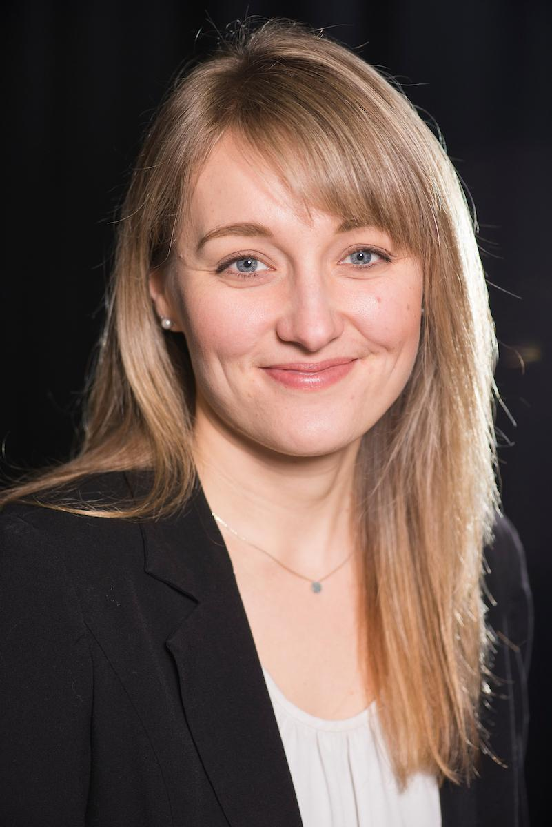

Introduction
Yuliya Dennis
Director of Alumni Career Services
Yuliya.Dennis@osualum.com
OREGON STATE UNIVERSITY
2
Notes:
Yuliya 12:03

Slide 4



Please feel free to ask questions during the webinar via the “Chat Box”
Questions will be addressed throughout the webinar
Link to the presentation will be emailed to you
Notes:
Yuliya

Slide 5

OSU Alumni Association Career Services
http://www.osualum.com/careers
Notes:
Yuliya

Slide 6
Webinar overview
Identify key aspects of a professional development plan
Understand the importance of networking
Describe ways you can professionally develop yourself
Learn how to expand career opportunities
Learn which skills and experiences to prioritize that will have the highest return on investment
Notes:
Yuliya 12:08

Slide 7
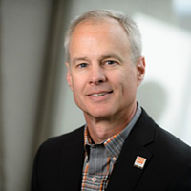
Introduction
Mark Conan ‘83
Business from Oregon State University
VP of Finance and Chief Financial Officer for Plaid Pantries, Inc. from 2003 until his retirement in 2016
Notes:
Mark 12:10

Slide 8
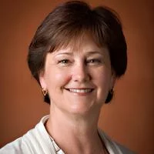
Introduction
Pam Knowles ‘77
BS in History and Education
Principal of Pam Knowles Consulting
Partner, Davis Wright Tremaine
OSU/COB Exec Dir for External Relations Portland Public Schools Board of Directors
Notes:
Pam 12:12

Slide 9
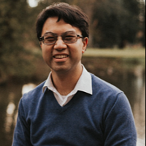
Introduction
Benny Kuo ‘17
MBA from Oregon State University
Career coach strategist
Marketing, CDSG (computer industry)
Notes:
Benny 12:14

Slide 10

Start where you are
Assess where you are now
Do a SWOT analysis
Determine Strengths, Weaknesses, Opportunities and Threats in your career
Notes:
Pam 12:15

Slide 11

Planning and Goal Setting
Establish broad goals
Define the steps and include timelines
Notes:
Pam
Establish a professional development plan with broad goals
Define the steps to get you to each goal – include timelines

Slide 12

Professional Growth
Get involved in professional organizations
Read professional journals or articles
Look for young leaders organizations
LinkedIn
Notes:
Pam 12:20

Slide 13

Poll question
Notes:
What do you think is the most important part of a professional development plan? (Put responses into chat box)

Slide 14

Motivation
Find something you enjoy doing
Have people in your circle who encourage you and who you encourage
Notes:
Benny 12:25

Slide 15

Build your skills
Understand your strengths and value
Build your skills with continuing education
Notes:
Benny

Slide 16

Personal brand
Create a cohesive values and mission statement
What words describe you?
Values alignment
Notes:
Benny

Slide 17
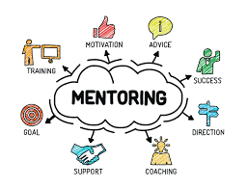
Mentorship
Find people that do what you want to do
Find sounding boards
Variety of mentors
Notes:
Benny 12:30

Slide 18
Poll question
Notes:
What area do you think is strongest for you?
Personal branding
Professional plan
Networking or meeting more people
Mentorship relationships
Other:

Slide 19

Connecting with others
Plan to meet new people
Treat networking as most important job you have
Notes:
Mark 12:35

Slide 20

How to network
Allocate significant time in your schedule time for meetings
  Referrals - business, family, friends
  About 20 minutes
  If you were in my position,
who would you talk to?
Notes:
Mark

Slide 21

Keeping track of it all
LinkedIn
Spreadsheet
Business cards
Notes:
Mark 12:40

Slide 22
Poll question
Notes:
What area do you need to work on most?
Personal branding
Professional plan
Networking or meeting more people
Other:

Slide 23

Networking at an Event
Be focused
Have an elevator pitch
Limit your time talking to each person
Have a card ready
Ask for a meeting
Notes:
Pam 12:45

Slide 24



Build Your Network With Involvement
Join a civic board
Write an article
Post work related articles or thoughts on social media
Use LinkedIn
Notes:
Pam

Slide 25
Poll question
Notes:
Are you looking for new employment? Yes or No
Comment:
What else can we cover today that you thought we’d cover or that you have questions on?

Slide 26

Summary
Assess where you are and create a plan
Professional development is about meeting new people in your industry
Connect, connect, CONNECT
Notes:
Summary 12:50
Pam
Benny
Mark

Slide 27
Next Steps
1. Join the LinkedIn Groups
OSU alumni, students, or staff/faculty can join the OSU Beaver Careers LinkedIn group: https://www.linkedin.com/groups/4379238
International OSU Alumni, student, or staff/faculty? Join our Int’l LinkedIn group: https://www.linkedin.com/groups/8313371/
2. Message Yuliya one take-away from the webinar
You will be entered to win a free career consultation!
Notes:
Yuliya 12:55

Slide 28
Follow up
Yuliya Dennis
Director of Alumni Career Services
Yuliya.Dennis@osualum.com
OREGON STATE UNIVERSITY
27
Notes:
Yuliya 12:55
Here are services I provide, ambassadors you can connect with you, help you with your career goal

Slide 29

Agenda
OSU
Oregon State’s Professional Development Programs
Technical Writing Online Class
February 10
Distillery Startup Workshop
March 9
Online Yoga Class
March 30
www.workspace.oregonstate.edu | 541-737-4197
Notes:
Yuliya and Greg

