Slide 1

MODULE 4
HIGH-5 COMMUNICATION TEAM PERFORMANCE SPECIFICATION IN PLAY
Notes:
Module 4 concludes this training. Take time to review prior training content with participants.

Slide 2

Goal
To align and practice High-5 communication skills and identify cultural elements everyone possesses.
Objective
So that labor and industry workers advance their cross-cultural communication skills , and cultural intelligence.
Why?
Because, culturally intelligent team members lead to more inclusive behaviors, enhanced cultural understanding. and increased productivity.
Notes:
In Module 1, we went through the importance of the High-5 Elements for Culturally Intelligent Communication and explored the topic of culture, and how it affects our world views and the way we communicate.
In Module 2, we went deeper into the first 2 High-5 elements: Evaluate and Navigate, and gained awareness around accounting for our own biases.
In Module 3, we discussed the last 3 elements of High-5 Culturally Intelligent Communication: Negotiate, Collaborate, Cooperate, and how can we successfully perform them with Civility in Mind.
Module 4 continues to explore and address how the High-5 Elements work together and are inter-dependent on each other.

Slide 3

What is culture?
Definition:
Culture is the characteristics and knowledge of a particular group of people, which includes: arts, traditions, religion, language, cuisine, music and dance, and social habits.
Culture:
Informs our behaviors
Influences our preferences and choices
Impacts communication styles
Definition
Notes:
With the group, revisit the question: What is culture?
Ask the group what else they remember from Module 1.

Slide 4
Culture is:
The way we all make sense of the world
EVERYONE regardless of race or ethnicity has a culture
Our brains use cultural information to give everyday events meaning

Slide 5
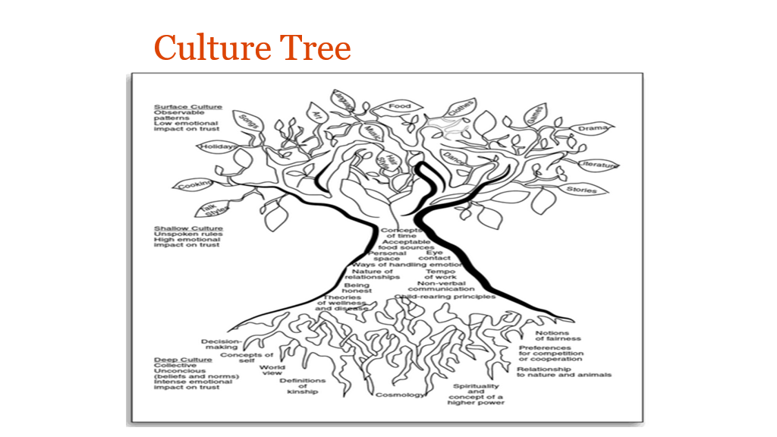
Culture Tree
Source:
Culturally Responsive Teaching and the Brain, Zaretta Hammond,

Slide 6
BREAKOUT GROUPS…. REPORT BACK
Notes:
Small group activities are recommended to help participants feel safer to share their opinions and experiences. We encourage you to include as many small group activities as you can accommodate. Instruct each group to designate someone to "report back" to the larger group after each breakout session.
While these activities are usually very helpful for participants, we recommend that you pay close attention to power dynamics within the groups and accommodate as needed to ensure that participants who belong to historically marginalized/underrepresented communities can feel as safe and included as possible.

Slide 7
On the Job Scenarios

Slide 8
Each group will be provided a different case scenario to discuss. Read and discuss the work scenario then as a group respond to the following questions.
How would you handle the situation?
How would you apply CQ in your communication?
Describe which High-5 communication elements you would consider applying in the way you would respond to the issue you are facing?
Notes:
During case study activities, remind participants to make use of the High-5 Elements for Effective Team Communication:
You evaluate what tools you’ll need
You navigate the working space
You negotiate sequence of how and when tasks are done
You collaborate as a team (no one does it all)
And, you co-operate with your team to get the job done!
Provide the on the job scenarios to participants. In virtual environments this can be accomplished by sharing the slide information through the chat field. You can do the same with the following slide which describes each element in detail.
Please instruct learners to use the High-5 Elements for Effective Team Communication handout as well as the case scenario for this activity. Allow 20-25 minutes.
You can prepare your own case scenario or refer to the Case Scenarios Addendum to choose a scenario.

Slide 9
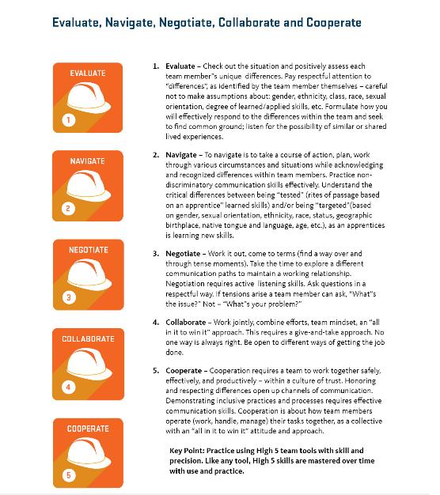
Notes:
HAND OUT: Participants should have a copy of the 5 key elements document to read, review, and serve as a constant visual aid. DISCUSSION GUIDE: High-5 tools improve communication skills over time. Like any tool; High-5 skills are mastered over time with practice.

Slide 10
BREAKOUT GROUPS…. REPORT BACK
Notes:
Give participants a 1-2 minute warning before closing the breakout rooms to allow for closure in conversations. Ask one person from each group to share key insights from their group, without naming their colleagues or exposing sensitive details.

Slide 11
Before we speak up for Inclusion, we need to speak about inclusion.
#SpeakUpforInclusion
Notes:
Accounting for cultural differences

Slide 12
BREAKOUT GROUPS…. REPORT BACK
Notes:
Small group activities are recommended so participants feel more safe to share their opinions and experiences. We encourage you to engage in as many small group activities as you can accommodate.
While these activities are usually very helpful for participants, we recommend that you pay attention to power dynamics within your group and accommodate so participants that belong to historically marginalized/underrepresented communities can feel as safe and included as possible

Slide 13
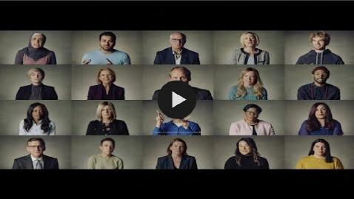
Inclusion: What is It?
https://www.youtube.com/watch?v=pBBirlVxVsg&feature=emb_title
Instructor Note 19
69
Notes:
https://www.youtube.com/watch?v=pBBirlVxVsg&feature=emb_title
This video addresses inclusion. Give participants 5-10 minutes to view the (4 minute) video, or watch it as a group. After viewing, ask participants for reactions, questions or comments. An instructor may use the following prompts to encourage conversation and group engagement:
How and why might some of the people in the video be excluded in a working team? How does exclusion impact productivity in working teams?
What strategies can we use to avoid excluding team members?

Slide 14

Question for group discussion:
How do we create an environment of inclusion in our teams?
Notes:
Encourage participants to think back to the My view of the world activity, and the 3 different levels of culture when responding to this prompt.

Slide 15






Embracing Collaboration
Across Difference
Practicing
Cultural
Humility
Attending to Environmental Factors
Engaging
the Here
and Now
Redressing Historical & Contemporary Inequities
Maintaining
Global Consciousness
Notes:
Becoming aware of, and responsible for, our culture and how we navigate differences in the workplace is a journey, not a destination.
All participants are invited to continue this journey by exploring the tools and resources available to you in the appendix section.

Slide 16

Check Your Knowledge
In diverse teams, why is it important to take notice of (evaluate) cultural differences?
TRUE OR FALSE (T or F)
The best way to apply the High-5 communication skills is to practice them.
Working with diverse team members requires I adapt my behaviors in ways that respects other’s differences. This means I have to give up my own (cultural) values and beliefs.
Sometimes I have to work with team members that aren’t respectful of differences. Some things I might say are . . .
Hey, that is not OK.
Why are you doing (saying) that?
That’s not helpful
STOP!
That’s not how we treat our teams
We need everyone’s ideas.
Everyone’s ideas count
Be fair
Instructor Note 26
Notes:
Use these questions to check in with your participants. Leave time for a group discussion about ways we can all interrupt disrespectful behavior/situations. Instructors may use the list on the right of the slide above, or ask participants to develop their own list.
For virtual environments, make use of the poll tool in Zoom. You may need to remind attendees to exit the poll window after the final results are shared.

Slide 17
CONSOLIDATION: WHAT DO YOU REMEMBER FROM TODAY?

Slide 18
Activity: Where do you stand?
AGREE
DISAGREE
NEUTRAL
Notes:
Use the following prompt as a final check in with your attendees: I feel I am more equipped to navigate differences in the work place: Agree, Neutral, Disagree.
For virtual environments, use the slide above and instruct participants to use the Annotated feature in zoom to provide anonymous feedback.
Participants may also want to verbally respond to this final prompt with comments or questions.

Slide 19
THANK YOU
Notes:
END TRAINING. Provide any information about next steps or follow up from your organization.

