Slide 1
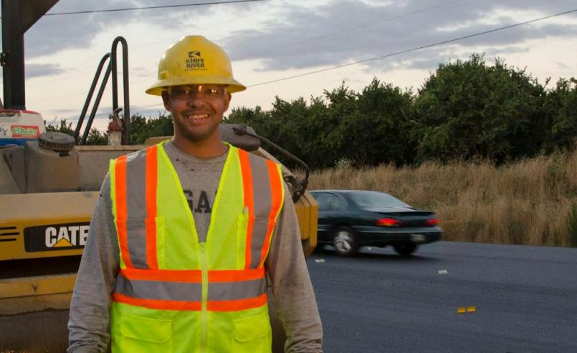
MODULE 3 THE RIGHT TOOL AT THE RIGHT TIME: WHAT DIFFERENCE DOES “DIFFERENCE” MAKE?
Notes:
Module 3: What Difference does "difference" make?

Slide 2
CONSOLIDATION: WHAT DO YOU REMEMBER FROM LAST WEEK?
Notes:
Engage your group by asking participants to name concepts or information from your prior session, if applicable.

Slide 3
Goal
To critically think about each of the five key communication elements and apply them to work scenarios. We will focus on the external three High-5 elements: Negotiate, Collaborate and Cooperate.
Objective
High–5 key element applicability in day- to-day work. Ability to apply and put into practice the High–5 communication skills.
Notes:
The first two High-5 elements focus on our inner minds while the last 3 address external factors.

Slide 4

Group Engagement
Speak from your own lived experiences
Respectfully listen to differences
Examine your own assumptions
Approach conversations with curiosity while noticing any judgment or stereotypical thinking
Listen for ways to enhance your cultural communication skills
Notes:
Engage participants in a discussion by asking: Do I always have to agree with the other people's worldviews?

Slide 5
Cooperate
Collaborate
Negotiate
Navigate
Evaluate
Foundations of Successful
Communication
Notes:
Consolidation:
It is important to note that, The High-5 Elements are the foundation for effective culturally intelligent teams, who communicate across difference. Please take time to discuss with workshop participants how each element of the pyramid is dependent on the other elements. For example, you can´t get to co-operation without first evaluating the situation, navigating differences, negotiating and collaborating.
Reminder: The first 2 High-5 elements focus on our inner minds, while the last 3 are external.

Slide 6
Evaluate
Evaluate the situation. Careful not to make assumptions about: gender,
ethnicity, class, race, sexual orientation, skills (team member may still be learning), etc.
Formulate how to effectively respond to the differences within the team and seek to find common ground; listen for the possibility of similar or shared work and/ or lived experiences.
Instructor Note 14
Notes:
Consolidation: Remind the group of content from the last module: Evaluate

Slide 7
What is the issue?
What needs to be understood in order to address the issue?
Why is the issue significant to teams?
What is the ideal outcome?
What actions can be taken by team members to address the issue?

Slide 8
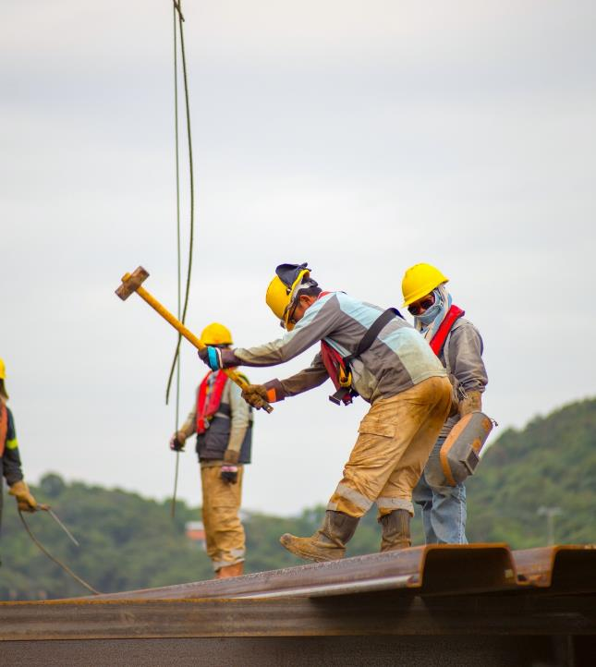
Navigate
Have a plan or course of action to communicate with a diverse workforce. Adapt to various cultural circumstances and situations. Practice non-discriminatory communication skills. Examples:
My plan is not to engage in demeaning talk toward a team member.
My plan is to listen more carefully
My plan is to pay attention to my assumptions.
My plan is to interrupt derogatory communication
Notes:
Consolidation: Remind the group of content from the last module: Navigate

Slide 9

Negotiate
Work it out: Come to terms and find a way over or through tense moments. Explore different communication paths.
Ignoring and dismissing the situation may not improve the situation. When tensions arise safely* address the issue and explore solutions.
Negotiation is about understanding another’s perspective. Ask questions in a respectful way.
Notes:
This module explores strategies to negotiate, collaborate and cooperate, using our new understanding of bias and culture.
Define negotiate, keeping in mind the specific context of your group.

Slide 10

Collaborate
Work jointly, combine efforts and shift the team mindset to an ‘all in it to win it’ approach. This requires a give-and-take mindset and an understanding there may be multiple ways to complete a task.
Be open to different ways of getting the job done.
Solutions and ideas are generated from multiple perspectives.
Notes:
Define collaborate, keeping the context of your group in mind.

Slide 11
Cooperate
Cooperation requires a team work together safely, effectively, and productively – within a culture of trust.
Honoring and respecting differences opens up channels of communication.
Demonstrating inclusive practices and processes requires effective communication.
Cooperation is about how team members operate (work, handle, manage) their tasks together, as a collective with an ‘all in it to win it’ attitude and approach.
Notes:
Define cooperate, with the context of your group in mind.

Slide 12
BREAKOUT GROUPS…. REPORT BACK
Notes:
Small group activities are recommended to help participants feel safer to share their opinions and experiences. We encourage you to include as many small group activities as you can accommodate. Instruct each group to designate someone to "report back" to the larger group after each breakout session.
While these activities are usually very helpful for participants, we recommend that you pay close attention to power dynamics within the groups and accommodate as needed to ensure that participants who belong to historically marginalized/underrepresented communities can feel as safe and included as possible.

Slide 13
Each group will be provided a different case scenario to discuss. Read and discuss the work scenario then as a group respond to the following questions.
How would you handle the situation?
How would you apply CQ in your communication?
Describe which High-5 communication elements you would consider applying in the way you would respond to the issue you are facing?
Notes:
Encourage learners and participants to make use of the High-5 elements for Effective Team Communication:
You evaluate what tools you’ll need
You navigate the working space
You negotiate sequence of how and when tasks are done
You collaborate as a team (no one does it all)
And, you co-operate with your team to get the job done!
Provide the on the job scenarios to participants. In virtual environments this can be accomplished by sharing the slide information through the chat field. You can do the same with the following slide which describes each element in detail.
Please instruct learners to use the High-5 Elements for Effective Team Communication handout as well as the case scenario for this activity. Allow 20-25 minutes.
You can prepare your own case scenario or refer to the Case Scenarios Addendum to choose a scenario.
We will continue practicing the High-5 Elements for Effective Team Communication through the remainder of this training.

Slide 14
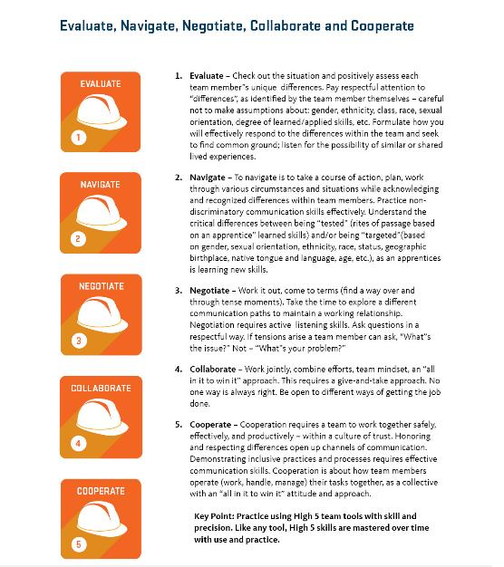
Notes:
HAND OUT: Participants should have a copy of the 5 key elements document to read, review, and serve as a constant visual aid. High-5 tools improve communication skills over time. Like any tool; High-5 skills are mastered over time with practice.

Slide 15
BREAKOUT GROUPS…. REPORT BACK
Notes:
Give participants a 1-2 minute warning before closing the breakout rooms to allow for closure in conversations. Ask one person from each group to share key insights from their group, without naming their colleagues or exposing sensitive details.

Slide 16
Civility
Notes:
https://www.youtube.com/watch?v=YY1ERM-NIBY
Please watch this TED talk as a group. If you are delivering this curriculum remotely, we recommend that you allow participants to watch the video individually and then do small break out groups for discussion.
This video is approximately 15 minutes and you can instruct your participants to take a 20 minute break, and come back and be ready to discuss this.

Slide 17
BREAKOUT GROUPS…. REPORT BACK
Notes:
Small group activities are recommended to help participants feel safer to share their opinions and experiences. We encourage you to include as many small group activities as you can accommodate. Instruct each group to designate someone to "report back" to the larger group after each breakout session.
While these activities are usually very helpful for participants, we recommend that you pay close attention to power dynamics within the groups and accommodate as needed to ensure that participants who belong to historically marginalized/underrepresented communities can feel as safe and included as possible.

Slide 18
Questions:
What was surprising to you about the TED talk?
Have you experience the effects of incivility?
How does it feel like to be welcomed?
Can you see a relationship between civility and effective communication?
Notes:
Th questions to debrief the TEDtalk as a group, or with the

Slide 19

The best communication tools are awareness of our own culture and respect for others.

Slide 20
Activity: Where do you stand?
AGREE
DISAGREE
NEUTRAL
Notes:
In order to asses the level of engagement of the group, you can ask the following prompt:
“I feel I am more equipped to navigate differences in the work place”
Then, allow participants to use the Annotated feature in zoom to provide anonymous feedback.

Slide 21
THANK YOU

