Slide 1

MODULE 2
HIGH-5 TEAMS: SKILLFUL USE
OF COMMUNICATION TOOLS
Notes:
Module 2: High-5 Teams: The Skillful use of communication tools.
This module will focus on how to be mindful of stereotypes, and how they can affect and hinder effective team communication.

Slide 2
CONSOLIDATION: WHAT DO YOU REMEMBER FROM LAST WEEK?
Notes:
Engage your group by asking participants to name concepts or information from your prior session, if applicable.

Slide 3

Goal
To construct respectful and productive team by developing effective, culturally adaptable communication skills. In this module, we will focus on Bias and Generalizations.
Objective
So that culturally inclusive working teams and work environments are established

Slide 4
Group Engagement
Speak from your own lived experiences
Respectfully listen to differences
Examine your own assumptions
Approach conversations with curiosity while noticing any judgment or stereotypical thinking
Listen for ways to enhance your cultural communication skills

Slide 5
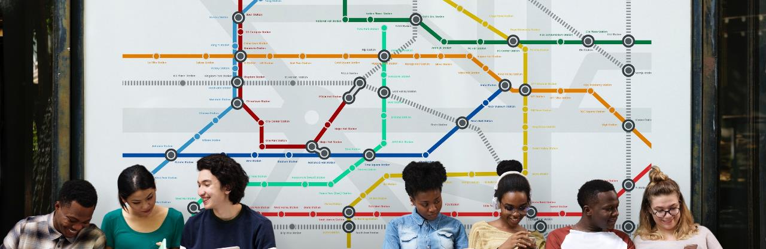
Take a Stand Activity
There is more difference between members of any
one group than there is across any two groups.
Lewontin, 1972
Notes:
Objectives of the Activity
This training is about developing Cultural Intelligence (CQ). A crucial part of CQ is to realize how diverse teams function ,and how diversity leads to difference world views.
Instructions
Prior to engaging in this activity, create a path or open space that spans from one side of the room to another that is free of chairs, desks, and any other type of furniture. This is needed so that students may form a line. On one side of the room place an ‘Agree’ sign in large, legible print and on the opposite side of the room place the sign ‘Disagree.’ Explain to apprentices that they may choose to stand on either side of the room based on how they feel about the topic/sentence that is read aloud. If they neither ‘Agree’ nor ‘Disagree,’ explain that they may stand in the middle of the room to indicate that they are “undecided.”
Inform the participants this activity will be done in silence. The facilitator will read a statement out loud, and then participants should quietly move to the directional
spectrum that aligns with their experiences in relation to the statement. Ask participants to be aware of where they and other participants are throughout the activity.
During each statement the facilitator should give participants ample time to reflect, move accordingly, and observe where participants align themselves. At the end of all statements made, have participants come back together to debrief what they noticed and what it was like to participate in the activity.
This activity can be adapted for virtual environments using the annotate tool and following 2 slides.

Slide 6
Where do you stand?
AGREE
DISAGREE
NEUTRAL
Notes:
For virtual environments, allow time to explain participants how to use the Annotate tool, and allow for practice.

Slide 7

Warm-up Statements
Chocolate is the single best ice cream flavor
Rainy days are way more fun than sunny days
Being happy is the ultimate most valuable goal in life
Humans are part of the animal kingdom
Instructor Note 5
Notes:
Debrief: Invite comments from the group, utilizing the Group Agreements, as needed. Remind participants that the objective of this activity is to explore and provide a window into diverse opinions and worldviews. Further debrief this activity by explaining how experience is often shaped by identity. Invite participants to think about how society values or de-values certain identities.

Slide 8
Follow-up Statements
In today´s society schools in the United States provide equal opportunity to everyone
Most people in the world mean well
The world is a fundamentally dangerous place
Gender identity is made up by humans or society
Sometimes teammates assume I can’t do some tasks because of my gender, race, or some other form of difference
Teammates often make comments about my appearance
The concept of race was made up by humans or society
All members of society have equal opportunities to succeed. It’s simply a matter of “pulling themselves up by their bootstraps.”
Instructor Note 5
Notes:
Debrief: Invite comments from the group, utilizing the Group Agreements, as needed. Remind participants that the objective of this activity is to explore and provide a window into diverse opinions and worldviews. Further debrief this activity by explaining how experience is often shaped by identity. Invite participants to think about how society values or de-values certain identities.

Slide 9

My view of the world
How does where I am on the continuum affect my values, beliefs, customs and behaviors (view of the world) and how I interact with those around me?
Notes:
This activity has the potential to create disagreements. Be prepared to facilitate tension that may arise within the group. Refer to the Group Agreements, as needed.

Slide 10
What came up for you?
Our personal culture has a great impact on how we see the world
It is harder to see our own culture than to see someone else´s
Remember how even small things can have an impact on how we interact with others

Slide 11
“What is necessary to change a person is to change his awareness of himself.”
~Abraham H. Maslow

Slide 12
BREAKOUT GROUPS….
REPORT BACK
Notes:
Small group activities are recommended to help participants feel safer to share their opinions and experiences. We encourage you to include as many small group activities as you can accommodate. Instruct each group to designate someone to "report back" to the larger group after each breakout session.
While these activities are usually very helpful for participants, we recommend that you pay close attention to power dynamics within the groups and accommodate as needed to ensure that participants who belong to historically marginalized/underrepresented communities can feel as safe and included as possible.

Slide 13
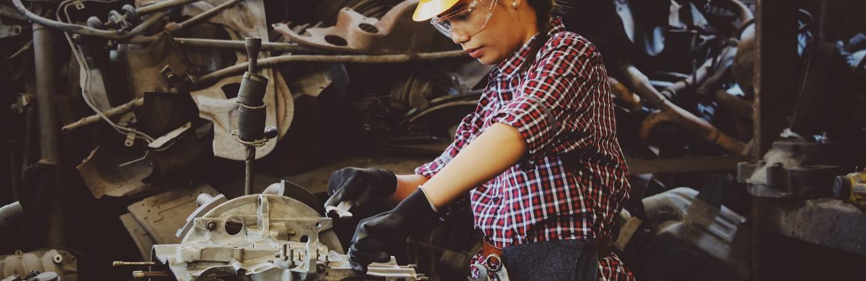
Reflect in Small Teams:
How do these values, beliefs, customs, and behaviors welcome or exclude those who bring differences to the group – both in our employment and the people in the community?
Notes:
Think back to the My view of the world activity and the 3 different kinds of culture.
Spend a lengthy bit of time on this slide. Help participants understand that our ‘culture’ is the lens by which we see the world. When having this discussion, it is also important to have a conversation about unconscious bias and what that is. We are all biased, it is simply how our brain works and how we learn.
The term “cognitive bias” refers to unconscious patterns of thought—including cognitive categories and shortcuts, or heuristics, which have the unintended effect of conferring advantage to some and disadvantage to others. Please be aware that biases are not necessarily a bad thing, however it is important to be aware of them and to reflect on how are our biases influence how we see the world.

Slide 14
BREAKOUT GROUPS….
REPORT BACK
Notes:
Give participants a 1-2 minute warning before closing the breakout rooms to allow for closure in conversations. Ask one person from each group to share key insights from their group, without naming their colleagues or exposing sensitive details.

Slide 15
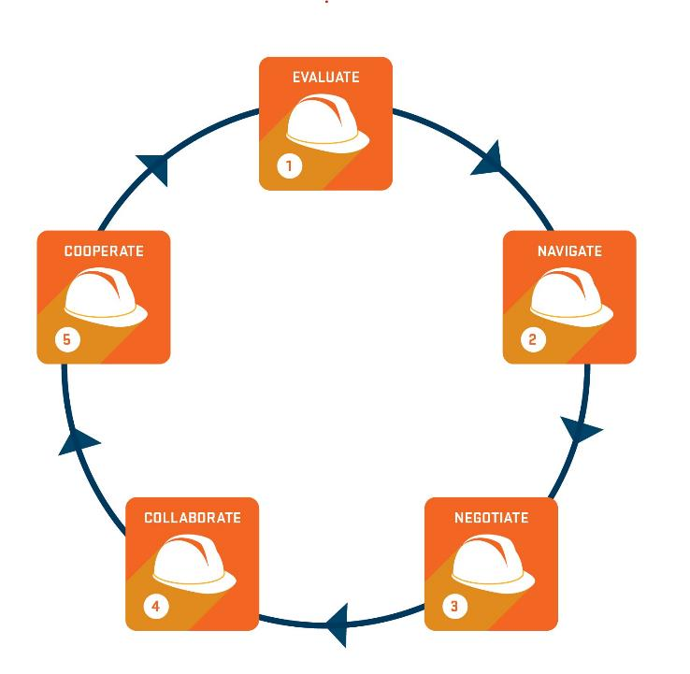

REMEMBER THESE?
Notes:
Consolidation: Ask participants, what are the High-5 Elements of Effective Communication? Participants may name one or all five.
We learn by exposure and practice.

Slide 16
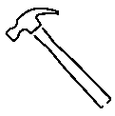
Tools of the Trade
Just as there are tools for labor and industrial trades - There are tools for communication. Ways you may already apply the High-5 Elements in your work:
You evaluate what tools you’ll need
You navigate the working space
You negotiate the sequence of how and when tasks are done
You collaborate as a team (no one does it all)
And, you co-operate with your team to get the job done!
Notes:
Spend some time engaging the participants in a dialogue about how they may already be applying the High-5 elements during their work.

Slide 17
Cooperate
Collaborate
Negotiate
Navigate
Evaluate
Foundations
of Successful
Communication
Notes:
The High-5 Elements are the foundation for effective culturally intelligent teams, who communicate across difference. Please discuss with workshop participants how each element of the pyramid is dependent on the other elements. For example, you can´t get to co-operation without first evaluating the situation, navigating differences, negotiating and collaborating.
Please note that the first two High-5 elements focus on our inner minds while the last 3 address external factors.

Slide 18

Evaluate
Evaluate the situation. Careful not to make assumptions about: gender,
ethnicity, class, race, sexual orientation, skills (team member may still be learning), etc.
Formulate how to effectively respond to the differences within the team and seek to find common ground; listen for the possibility of similar or shared work and/ or lived experiences.

Slide 19
What is the issue?
What needs to be understood in order to address the issue?
Why is the issue significant to teams?
What is the ideal outcome?
What actions can be taken by team members to address the issue?
Notes:
These 5 questions can help when navigating a situation. Focus on the root of the issue, and try to identify the space between the issue itself and the ideal outcome, when determining a path forward.

Slide 20

Navigate
Have a plan or course of action to communicate with a diverse workforce. Adapt to various cultural circumstances and situations. Practice non-discriminatory communication skills. Examples:
My plan is not to engage in demeaning talk
toward a team member.
My plan is to listen more carefully
My plan is to pay attention to my assumptions.
My plan is to interrupt derogatory communication
Instructor Note 15
50

Slide 21
How do we avoid stereotypes when navigating differences?
Notes:
How can we be mindful of stereotypes, and how can they affect effective team communication?

Slide 22
Difference between stereotypes and generalizations?
Cognitive short cuts
Grouping, categorizing
Organizing complex world
Making sense of diversity
Notes:
Encourage the group to think back to the conversation about culture and the brain, as they are introduced to differences between stereotypes and generalizations.

Slide 23
Rapid, mostly unconscious
Familiar versus
unfamiliar
In-group
Versus
out-group
Safe versus
not safe
Notes:
These 3 characteristics are common to both generalization and bias. They are mental shortcuts that we can´t avoid. However, we can become aware of them and interrupt with intentional breaks, (such as effectively applying the High-5 communication skills), so they don´t drive how we interact in the workplace.

Slide 24
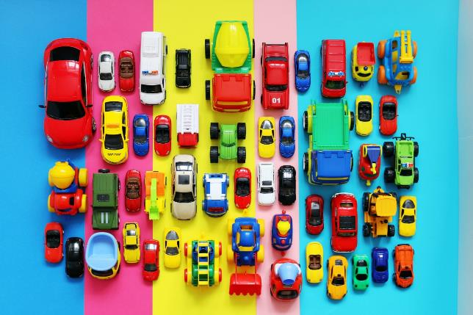
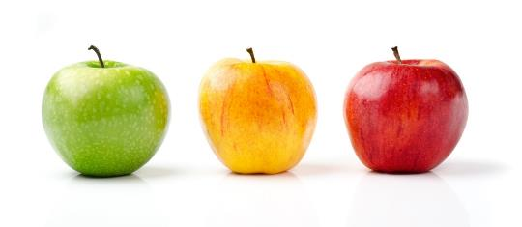
A Note on Generalizations
Notes:
This graph explains how generalizations work.
PACE PLEASE RE-CREATE

Slide 25
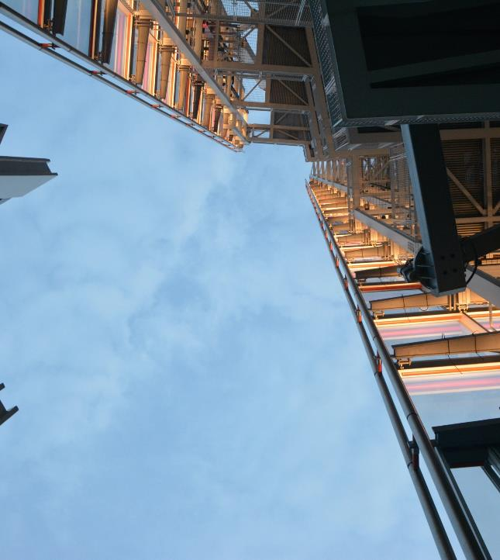
Stereotypes:
Categorize all members of a group as having the same characteristics.
May or may not be based in fact.
Tend to be inflexible and closed to new information.
Can lead to prejudice and intentional or unintentional discrimination.

Slide 26
Generalizations:
Categorize many members of a group as having similar characteristics.
Based on research or widespread observation.
Flexible and open to new information.
Can lead to curiosity, increased awareness, and improved cross cultural relationships.

Slide 27
Both stereotypes and generalizations are cognitive categories which organize our experiences. However, stereotypes are rigid. Generalizations are flexible.
We tend to ignore disconfirming evidence of stereotypes and over-elaborate confirming evidence.
Stereotypes determine our reactions; cultural generalizations inform them.
Notes:
Key takeaway: Stereotypes are rigid. Generalizations are flexible. Stereotypes determine our reactions; cultural generalizations inform them.

Slide 28
What are Biases?
Preferences or inclinations which can impair judgment; often used synonymously with “prejudices.”
 | Explicit (Conscious/Intentional | Implicit (Not Conscious/ Unintentional)
Individual | Personal Prejudice: bigoted beliefs and stereotypes, often leading to intentional negative or positive treatment based on identity | Cognitive Bias: pre-conscious cognitive categories/ shortcuts/thought patterns that unintentionally advantage/ disadvantage people based on identity
Systemic | Institutional Discrimination: Laws, policies, and practices designed to advantage/ disadvantage or include/ exclude based on identity | Structural Bias: Seemingly neutral norms, policies, patterns, practices, procedures, standards and symbols that, in effect, advantage/ disadvantage people/groups based on identity
 | IMPACT with INTENT | IMPACT without INTENT
Notes:
Use this chart to help illustrate characteristics of explicit and implicit bias.
Credit: OSU search advocate program (2018) all rights reserved

Slide 29


Cognitive and Structural Biases Reinforce
Each Other
Implicit Bias
Cognitive Bias
Structural Bias

Slide 30

1. In Social Systems
  Meaning of identity is socially constructed
  Social and cultural values shape our understanding of different identities
Past/hidden prejudices and their consequences influence social identity
Cognitive Bias
2. Humans develop
cognitive schemata
Mental “file-folders” of information about socially constructed categories of persons, places, things
Our brains collect everything we hear/see/learn about groups (regardless of whether we agree)
These serve as mental models/prototypes/expectancies
5. Groups
experience discrimination; seeing people in negative circumstances reinforces social beliefs about their identities
3. We encounter an individual
ALL humans use pre-conscious cognitive shortcuts or heuristics that use our prototypes as stereotypes
We select schema/category that most closely matches the individual
We use it to predict and understand their behavior, and to know how to react
4. Predicting
individual characteristics based on group membership leads to unintended discrimination

Slide 31

So should I just ignore my intuition?
NO…intuition prompts us to notice things that might be important.
If you are someplace where you may not be safe, pay attention to your intuition! It’s okay to make a mistake.
But when immediate safety is NOT at risk:
  Evaluate the question your intuition is raising…
  If it is important, get the facts to answer it accurately!

Slide 32
PRACTICE…. Who are you when
you are your best self?
Notes:
Ask participants to consider and describe what it looks and feels like to be their best self. What external and internal factors are present?

Slide 33
BREAKOUT GROUPS…. REPORT BACK
Notes:
Small group activities are recommended to help participants feel safer to share their opinions and experiences. We encourage you to include as many small group activities as you can accommodate. Instruct each group to designate someone to "report back" to the larger group after each breakout session.
While these activities are usually very helpful for participants, we recommend that you pay close attention to power dynamics within the groups and accommodate as needed to ensure that participants who belong to historically marginalized/underrepresented communities can feel as safe and included as possible.

Slide 34
On the Job Scenarios

Slide 35
Four apprentices are on a job site. All four are assigned jobs moving rebar and placing anchor bolts in cement. The males begin to move rebar while the two females are instructed to help place anchor bolts in cement poured days prior. When the women completed the anchor bolt task, they head over to help move the rebar and are told to go help the worksite cleanup crew.
Notes:
During case study activities, remind participants to make use of the High-5 Elements for Effective Team Communication:
You evaluate what tools you’ll need
You navigate the working space
You negotiate sequence of how and when tasks are done
You collaborate as a team (no one does it all)
And, you co-operate with your team to get the job done!
Provide the on the job scenarios to participants. In virtual environments this can be accomplished by sharing the slide information through the chat field. You can do the same with the following slide which describes each element in detail.
Please instruct learners to use the High-5 Elements for Effective Team Communication handout as well as the case scenario for this activity. Allow 20-25 minutes.
You can prepare your own case scenario or refer to the Case Scenarios Addendum to choose a scenario.
We will continue practicing the High-5 Elements for Effective Team Communication through the remainder of this training.

Slide 36
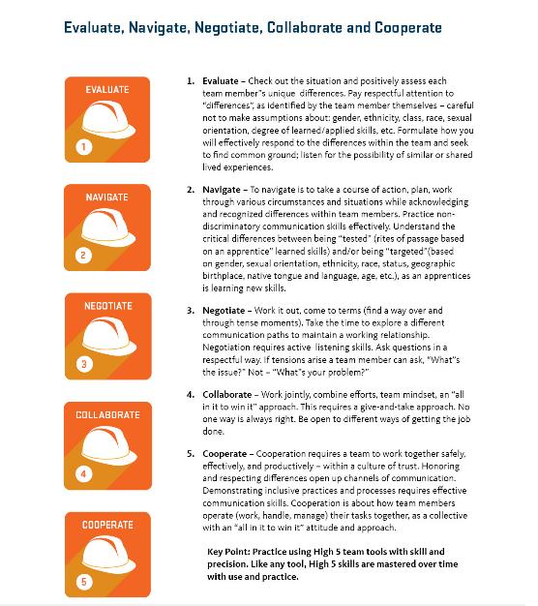
Notes:
HAND OUT: Participants should have a copy of the 5 key elements document to read, review, and serve as a constant visual aid.
DISCUSSION GUIDE: High-5 tools improve communication skills over time. Like any tool; High-5 skills are mastered over time with practice.

Slide 37
What is going on in this scenario?
What are the assumptions or stereotypical thinking in this scenario?
What can male team members say or do to include the women?

Slide 38
BREAKOUT GROUPS….
REPORT BACK
Notes:
Give participants a 1-2 minute warning before closing the breakout rooms to allow for closure in conversations. Ask one person from each group to share key insights from their group, without naming their colleagues or exposing sensitive details.

Slide 39
CONSOLIDATION: WHAT DO YOU REMEMBER FROM TODAY?

Slide 40
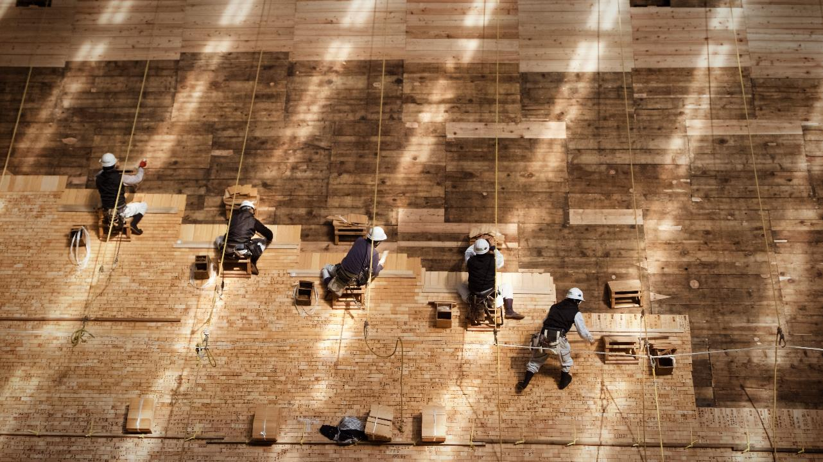
Evaluating a situation at work in which cultural differences exist requires one to (circle all that apply):
  Listen for commonalities
  Be careful not to make assumptions about: gender, ethnicity, class, race, sexual orientation, degree of learned/applied skills on the job, etc.
  Ask judgmental questions like: “You’re weird, why do you act the way you do?”
  Show genuine interest with respectful curiosity.
  All of the above
  A,B,& D
Notes:
Use this question to check in with the group, and leave time for any questions or comments.
For virtual environments, make use of the poll tool in Zoom. You may need to remind attendees to exit the poll window after the final results are shared.

Slide 41
Negotiating in communication means that:
If someone is being targeted based on gender, sexual orientation, ethnicity, race, status, geographic birthplace, native language, age – remain silent.
It means that I can move around and adapt to cultural differences without putting anyone down.
One is always learning – mistakes are made but one can master the skill.
B & C
A & C
Notes:
Use this question to check in with the group, and leave time for any questions or comments.
For virtual environments, make use of the poll tool in Zoom. You may need to remind attendees to exit the poll window after the final results are shared.

Slide 42
Activity: Where do you stand?
AGREE
DISAGREE
NEUTRAL
Notes:
Use the following prompt to assess the level of engagement of the group: “I feel I am more equipped to navigate differences in the work place.”
For virtual environments, use the slide above and instruct participants to use the Annotated feature in zoom to provide anonymous feedback.
Participants may also want to verbally respond to this final prompt with comments or questions.

Slide 43
THANK YOU
Notes:
Depending on how you are arranging your instruction of the High-5 Teams Curriculum, provide attendees with information for the next session, or any follow up that is needed.

