Slide 1


VOLUNTEERING FOR PROFESSIONAL GROWTH
OSU

Slide 2
Agenda
OSU
Agenda
Introduction to WorkSpace and Yuliya Dennis
Presentation & Follow Up
Contact Info and QA

Slide 3
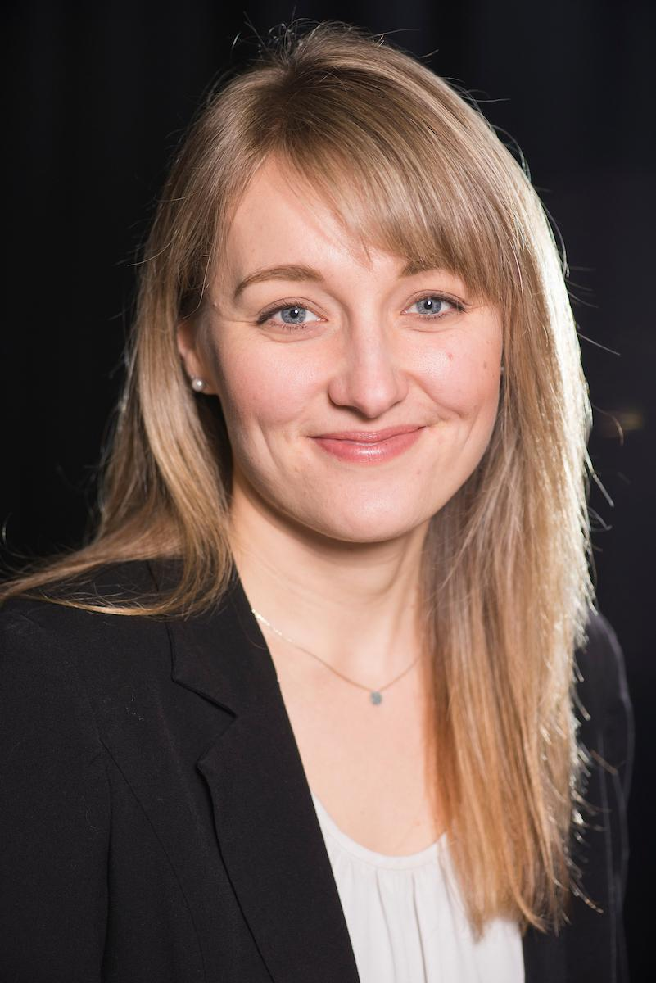

Introduction
Yuliya Dennis
Director of Alumni Career Services
Yuliya.Dennis@osualum.com
OREGON STATE UNIVERSITY
2

Slide 4



Please feel free to ask questions during the webinar via the “Chat Box”
Questions will be addressed throughout the webinar
Link to the presentation will be emailed to you

Slide 5

OSU Alumni Association Career Services
http://www.osualum.com/careers

Slide 6
Webinar overview
Investigate why volunteering can boost your professional growth
Understand the kind of volunteer opportunities that could be most helpful to your career and ways to find them
Assess your career goals and learn how volunteering can help you stand out from the crowd

Slide 7
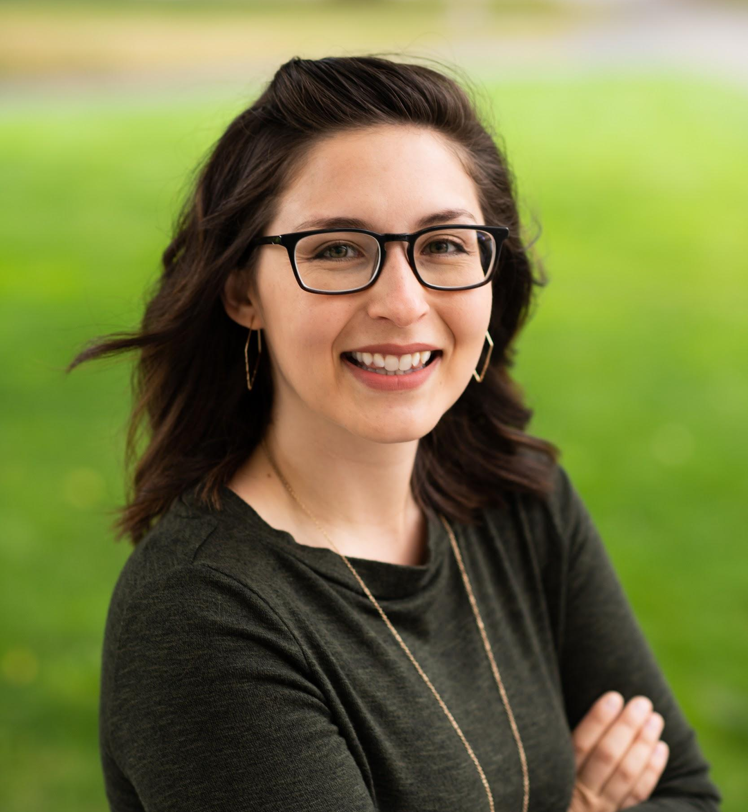
Introduction
Kim Ward Barowicz ‘11
Project Coordinator, UW Medicine
Seattle, Washington
OSU Alumni Career Ambassador
Notes:
Kim

Slide 8
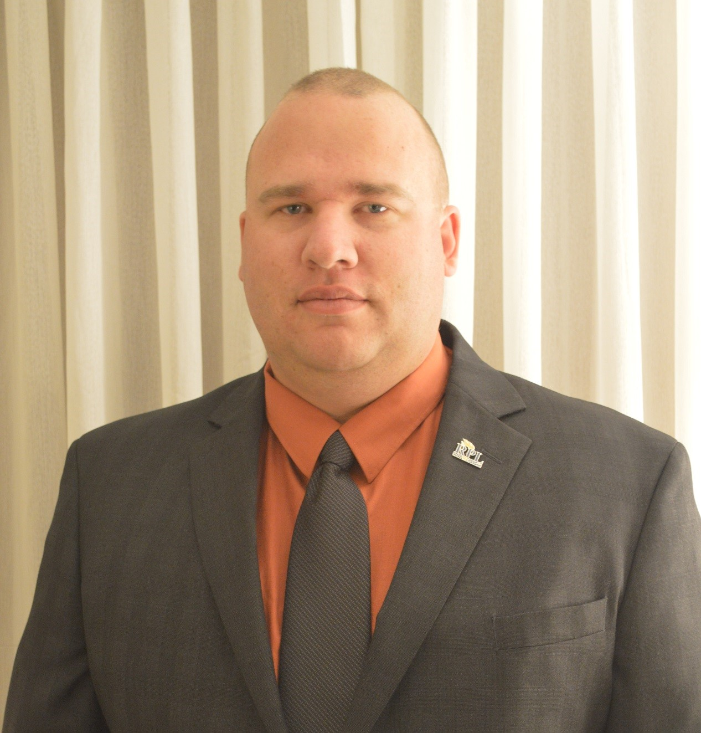
Introduction
George Long ‘05
Assistant Operations Manager at the Bureau of Emergency Communications Portland, Oregon
Notes:
George

Slide 9
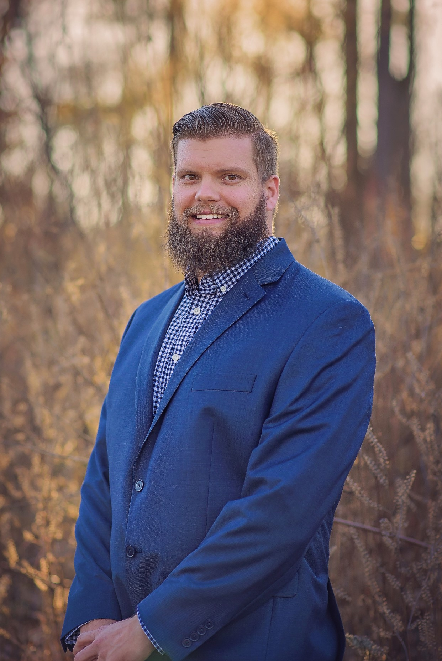
Introduction
Steve Ashley ‘11
Technical Service Project Manager at Georgia-Pacific Chemicals
Benton, Arkansas
OSU Alumni Career Ambassador

Slide 10

What is your “why”?
Why are you volunteering?
Relate it to your goals
Notes:
George 12:15

Slide 11

Focus
Do the right opportunities
What will contribute to your long term goals?
Example: career ambassador
Notes:
Kim

Slide 12

Do things to grow:
Find a company or organization
Add value to what they’re doing
Professional association
Notes:
Kim 12:25

Slide 13

Poll question
Notes:
Do you currently volunteer somewhere? Yes or no

Slide 14

Relating your volunteering
Be honest that it’s volunteer work
Do the time – not just for the resume
Use relatable skills
Notes:
George 12:30

Slide 15
Poll question
Notes:
What is your driving motivation for being part of this webinar? (Check all that apply or rank them 1-10)
Finding a job in a new industry (career pivot)
Building your general skill set
Connecting with community
Developing leadership skills
Networking and meeting new people
Giving back

Slide 16
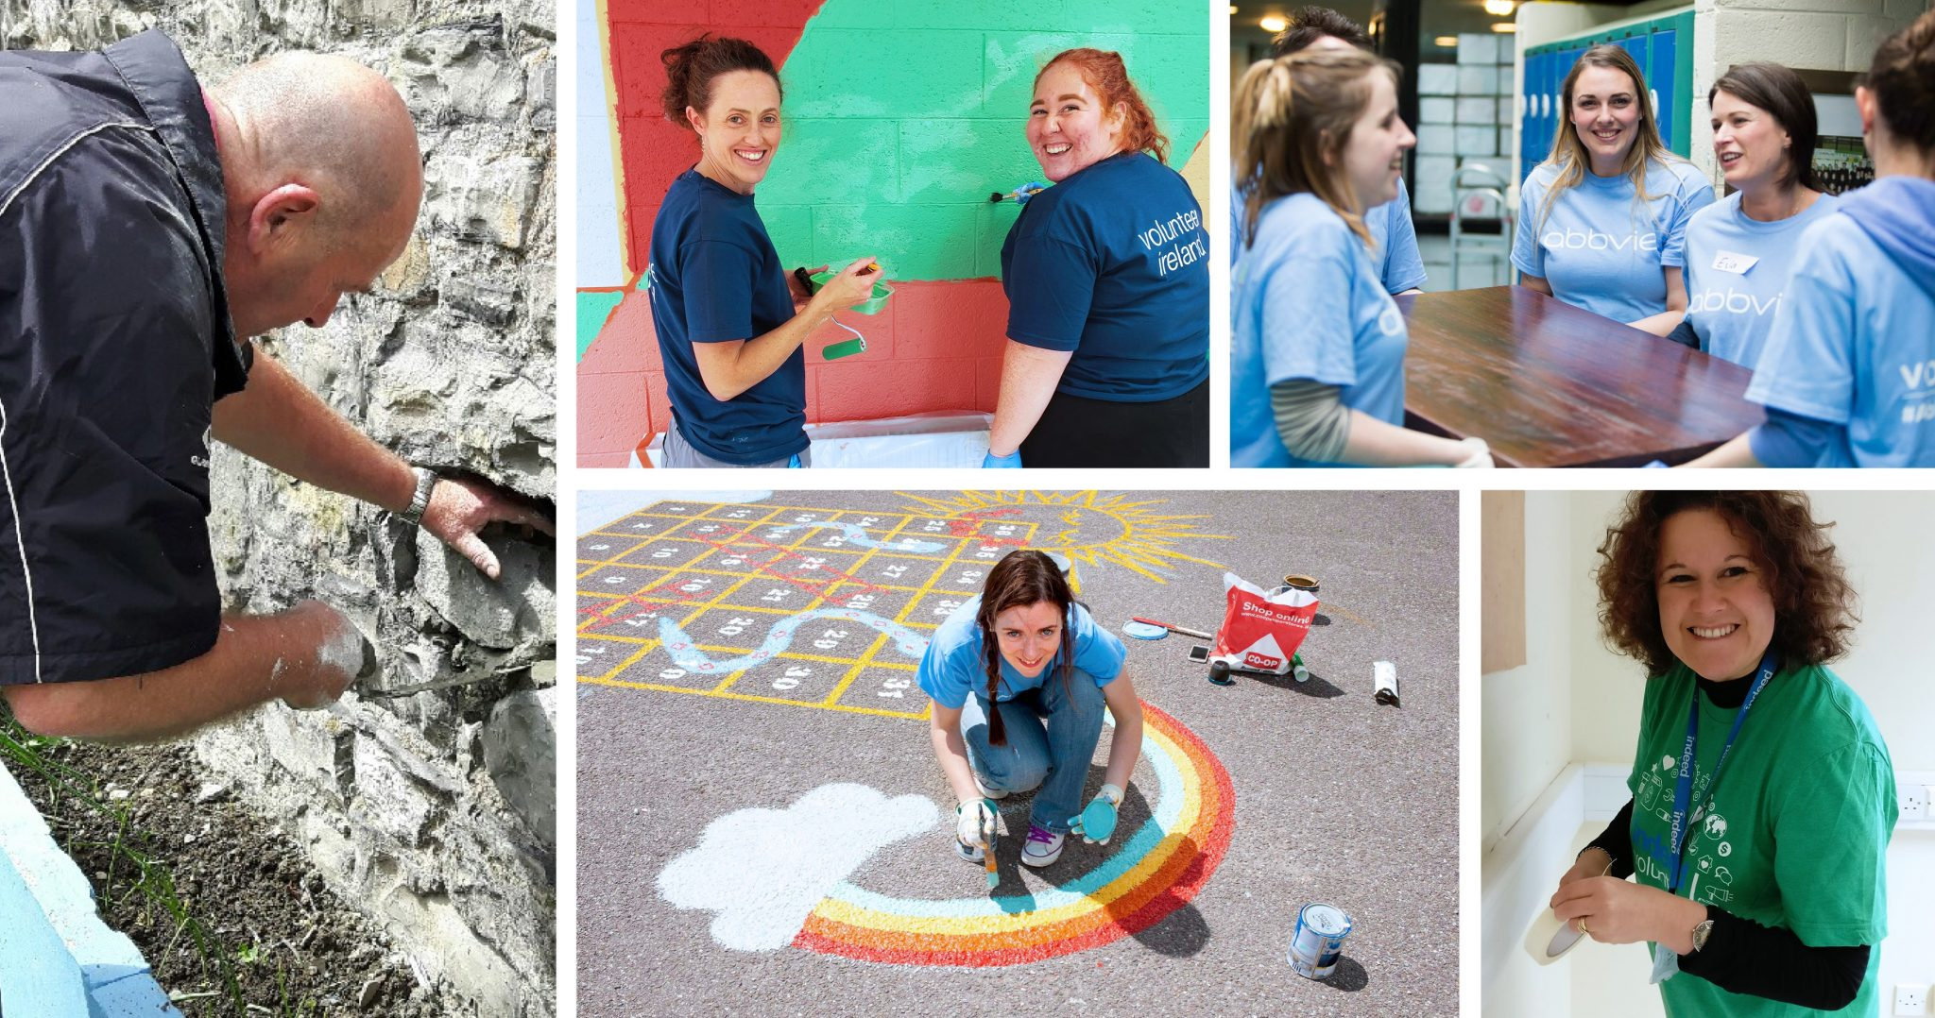
Remote worker perspective
Engage with communities
Social
connections
Notes:
Steve

Slide 17

How to make it more effective
Utilize time to be productive
Look at strengths and weaknesses
Develop networks and leadership skills
Notes:
Steve 12:40

Slide 18
Poll question
Notes:
Where do you volunteer? (Open ended)

Slide 19

Professional growth
SMART goals
Tying volunteering to goal setting
Future vision
Notes:
Yuliya

Slide 20

Career goals
Best practices for job searching
Importance of connections
Notes:
Yuliya 12:45

Slide 21
Poll question
Notes:
Are you planning on volunteering moving forward? Yes or no

Slide 22

Summary
What is your “why”?
Community engagement
Professional skills
Job searching
Professional growth
Notes:
12:50
Yuliya call on them in order: 1 key point from each
Kim: Find a way to turn your volunteer work into a referral by adding value to a company or cause
Steve
George

Slide 23
Next Steps
1. Join the LinkedIn Groups
OSU alumni, students, or staff/faculty can join the OSU Beaver Careers LinkedIn group: https://www.linkedin.com/groups/4379238
International OSU Alumni, student, or staff/faculty? Join our Int’l LinkedIn group: https://www.linkedin.com/groups/8313371/
2. Message Yuliya one take-away from the webinar
You will be entered to win a free career consultation!
Notes:
Yuliya

Slide 24
Follow up
Yuliya Dennis
Director of Alumni Career Services
Yuliya.Dennis@osualum.com
OREGON STATE UNIVERSITY
23
Notes:
Yuliya

Slide 25

Agenda
OSU
Oregon State’s Professional Development Programs
Prosecco Wine Tasting in Portland and Corvallis
December 7 and 13
Business Writing Online
January 6
Master Gardener Online Horticulture Certificate
January 6
www.workspace.oregonstate.edu | 541-737-4197
Notes:
Yuliya and Greg

