Slide 1
High-5 Teams
Developing Culturally Intelligent Communication

Slide 2
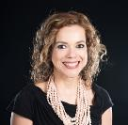
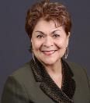
Course Development Team
Ana Lucia Fonseca
Maria Chavez-Haroldson
Maria Chavez-Haroldson is the Senior Consultant at EDI Consulting, LLC: an Equity, Diversity, and Inclusive organizational development consulting agency. Maria has over two decades experience as a national and international trainer. She is a Ph.D. candidate (Organizational Development – Leadership and Change). She has held various senior executive positions: Vice President of Organizational Development at Metropolitan Group, Director for Office of Inclusion & Intercultural Relations for Oregon Youth Authority, Associate Director for the Center for Latino Studies and Engagement at Oregon State University, Executive Director for CASA (Court Appointed Special Advocates), Director of Crime Victim Unit (Yamhill County District Attorney’s Office), Adjunct-Faculty with the Conference of Western Attorneys General Alliance Partnership, and Qualified Mental Health Professional working with immigrant families. She enjoys serving as an EDI professional coach and thinking partner with, and alongside organizational leaders.
Ana Lucia Fonseca has always had a passion for social change and the value that authenticity brings to organizations and the world. Before being an Professional of Inclusion, she was working as an Extension faculty in various community engagement programs such as creating Culturally Relevant STEM and Healthy Living curriculum. She has a BS in Social Psychology and MS in Natural Resource Education and Extension and is currently working on her PhD in Education. Before working at OSU she worked for the Federal Mexican Government implementing innovative rural development programs for indigenous communities. Areas of interest include: social justice, intersection between innovation and diversity, culturally relevant programming, healthy living and community empowerment.

Slide 3
Agenda
Training background
What is High-5 Teams?
Module 1: Effective Team Communication and Cultural Intelligence intro
Built-in breaks
This is for you! (please participate and take care of yourself)
Notes:
Welcome to High-5 Teams: Developing Culturally Intelligent Communication. As instructors, we recommend that you take time on the first day of the training to provide your participants with an overview of what the training is about, along with background information about why your organization is investing in this training.
Encourage your participants to take advantage of this learning opportunity as much as possible by participating during group discussions and activities, and to make the experience count for them by taking ownership of their own learning.
For longer training sessions, it is recommended that you share a detailed schedule with attendees, including when they can expect built in breaks.

Slide 4
Background
Why?
Notes:
During the next few slides, you will talk with your participants about the training background, purpose, and goals. You may choose to incorporate information from your specific program or industry. In addition to familiarizing yourself with the slide information in advance, you may also draw on your own experiences to help illustrate the need for this workshop, if you are comfortable doing so.

Slide 5
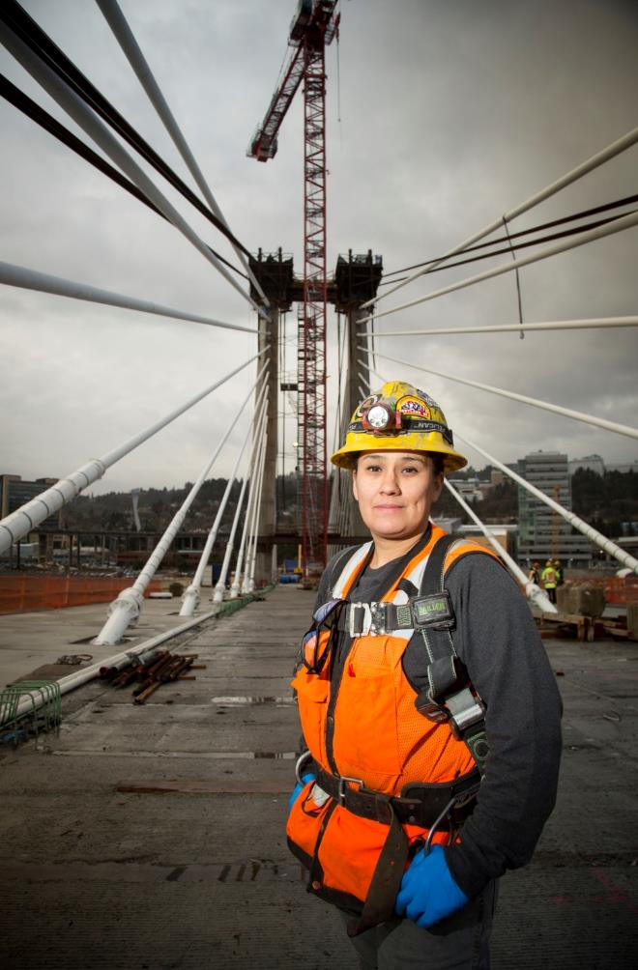
Train the Trainer Introduction
The Bureau of Labor and Industries' (BOLI) organizational vision is to promote a “strong and growing Oregon economy that reflects the values of fairness, equality, and opportunity.” BOLI's four principle duties are to: (1) protect the rights of workers and individuals to equal, non-discriminatory treatment through the enforcement of anti-discriminatory laws that apply to workplaces, housing and public accommodations; (2) encourage and enforce compliance with state laws relating to wages, hours, terms and conditions of employment; (3) educate and train employers to understand and comply with both wage and hour and civil rights law; and (4) promote the development of a highly skilled, competitive workforce in Oregon through the apprenticeship program and through partnerships with government, labor, business, and educational institutions.
BOLI, in collaboration with Oregon State University, introduces: High 5 Teams: Developing Culturally Intelligent Communication. This curriculum addresses the 21st Century, growing demographics within the labor and industry’s working environments. This curriculum provides inclusive instruction designed to develop Cultural Intelligence (CQ) and effective communication skills, thereby, supporting inclusive, effective, and productive working teams.

Slide 6

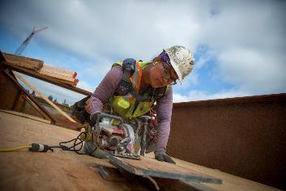

This training is designed to offer opportunities to expand cross-cultural communication skills and knowledge; to put them into practice in diverse working environments of the 21st Century.
Notes:
Cross cultural skills needs to be developed and practiced. It’s possible - just like reading!

Slide 7
Learning Goals
Identify High 5 Teams effective cross- cultural communication skills
Understand why diverse cultural communication skills are required in labor industries
Analyze how effective communication skills improves team trust and productivity
Differentiate effective and ineffective communication practices
Formulate more inclusive and ways of communication within diverse teams
Put into practice the High 5 Teams communication skills

Slide 8
Learning Outcomes
Outcome 1
Understand why effective, cross-cultural team communication skills are critical at the work site
Outcome 2
Comprehend how effective cross communication skills establish trust and improve team productivity
Outcome 3
Effectuate High 5 communication skills within diverse team members from diverse cultural backgrounds
Outcome 4
Develop an inclusive organizational work site culture which respects and values diverse work team membership

Slide 9
What our Objectives Are NOT
Shame
Blame
Belittle
Humiliate
Stress
Point Fingers
Divide
Lecture (we do not have all the answers!)
Notes:
We acknowledge that you have a lot of experience as instructors, and these are not your objectives. It is very important to share this information out loud with your group to help your learning environment stay positive.
If you want to go above and beyond in your facilitation of these topics, please utilize the many resources available to you in the appendix list.

Slide 10
HIGH 5 TEAMS
Evaluate, Navigate, Negotiate, Collaborate, and Cooperate
The High 5 Teams curriculum is an introductory (101 level) learning course which includes 4 sequenced modules. The modules are designed to:
Promote and help develop an inclusive organizational work site culture which respects and values diverse working team membership
Provide cross-cultural communication skills training which enhances cross-team knowledge transferability to any occupation within the labor and industries field
The modules are designed to engage adult learners, therefore, adult learning concepts are integrated within each module
Adult learners:
Want to know why concepts are being taught
Acknowledgement for prior life experiences and knowledge
Want to learn specific tasks
Want to experience self-directed processes leading to discovery
High 5 Teams includes videos, cases studies, activities, visuals and memory-prompting skill-building tools. Similar to apprenticeship specific tasks and tools of the trade, the High 5 skills can be used repetitively and from various communication starting points. Therefore, the High 5 elements may be applied and practice in any order based upon multiple situational team dynamics.
Notes:
Although these topics can be vast and complex, this curriculum was created with these specifics in mind.

Slide 11
Session Agreements
Group agreements are guidelines the group develops and agrees will serve as the foundation for effective communication throughout the instruction modules.
Examples Include:
Respect
No interruptions
Confidentiality
Honesty
Share air time (be brief allowing others to comment)
Approach conversations with curiosity, not judgment. We are all learning
Agree to disagree
Collaborate
Listen carefully
Speak from your experiences
Examine your own perceptions and assumptions
Notes:
Group agreements are to be co-created prior to each instruction session, by everyone in the training: instructor and participants.
For in person trainings, place a large sticky note on the wall for all to see throughout the instruction, as the instructors may need to refer to the agreements throughout the session. Include as many comments from the group as possible. For virtual trainings, this can be accomplished through screen sharing and group conversation. To prompt input, you may share this slide and ask participants: What other agreements are needed to have a safe and productive conversation?
Here are some specific situations that you may find in your session and how to navigate them:
Power-Over Group Dynamics – A participant or participants may sit toward the back of the training area to avoid active participation or to attempt to disrupt the training; in particular, if an element of the training they do not agree with is being presented. Setting group expectations up-front is critical. Also, invite all to turn their cell phones off or place them on silent. Ask if anyone is expecting a critical phone call during the training session. Set the stage, print the group engagement expectations and post where all in the training can see them. A strategy an instructor can use to balance power is to invite the participants to add to the group expectations. How might an instructor be perceived as having power-over the participants? Examples include standing over, or too closely to, participants and looking at a few participants more than others. Try to use equal eye contact with those in the training. Should tensions arise – use a calming tone to address the issues, not making threats of any kind. An instructor can also share their power by not “talking at” the participants, and rather inviting comments, sharing thoughts, and differences of opinion (with caution). Equity within the group must be kept in check – who is doing most of the talking? Instructors should role model inclusive practices, and patience, Emotional Intelligence, Cultural Intelligence (CQ), moderated voice tones, open body language, emotional regulation, and adult learning processes are needed.
Silence and Non-Participation – Participants remain silent; they do not offer any verbal comments. Non-participation may be a sign of discontent with having to participate in the training or disagreement with the topic(s) being presented. An instructor may choose to p-a-u-s-e by remaining silent after asking a question to encourage engagement. It is unnecessary to fill quiet spaces with constant instruction. Some cultures value silence during communication – reflective thought is important prior to offering a reply.
When the same participants raise their hands repeatedly, the instructor can respectfully say, “I am appreciating your active engagement. Let's open up this opportunity for others to comment – thank you”. Offer table topics or work group activities to invite participants to write or draw a response to a question or a scenario provided.
Body Language – Participant is slouching, un-attentive, dozing, etc. Strategy: Raise your voice a bit as you continue giving instructions. Move closer to the participant so as to get their attention and invite their engagement by asking them a question.
Interruptions – At times, participants may intentionally disrupt by engaging with others in conversation. Participants may want to emphasize their personal views or “take over” the training and become argumentative. Strategy: Acknowledge that people may share or differ with the opinion/perspective but the way we manage differences is what is key. Then move on with the training. If the participant continues insisting on making a point, respectfully explain that time is limited, and invite the participant to meet with you after the session.
Mediating Conflict – Make sure the group has (collectively) identified and agreed upon the session agreements prior to instruction. During conflict, the agreements may be referred to repeatedly. Acknowledge that there are differences of opinion, lived experiences, etc. If a particular conflict includes a topic directly related to the instruction and you possess conflict resolution skills, you may spend a few minutes further exploring the differences of thought as you model effective communication skills and CQ.
Sarcasm – Model CQ tone of voice in any response given. Draw attention to the group’s agreed upon communication/participation agreements which were developed (together) prior to the instruction. It may be necessary to take a break, to address the participant(s) and then to reconvene the group so as to not shame the participant.
Recommendation: Prepare strategies for maintaining and managing argumentative, combative, and/or hostile participants which are in alignment with direct reports (supervisor).
Instructor Characteristics
Able to articulate why cross-cultural communication is relevant in today’s labor and industries workplace
Able to articulate how and why demographically diverse teams are becoming more apparent in 21st century labor market
Understand the distinction between equity and equality
Be an inclusive team member
Practice cultural responsivity
Possess adaptable communication skills
Facilitate difficult dialogues on topics of race
Facilitate difficult dialogues on topics of gender, identity and expression, class, nationality
Possess conflict mediation skills
Be confident
Demonstrate patience
If you want to go above and beyond in your role as facilitation of these topics, we recommend your check the amazing resources available in the appendix list

Slide 12
Training Tools and Resources
Zoom video conference platform
Annotations
Pools
Feedback
Breakout rooms
Notes:
Take time to explain your virtual platform, or any other tools or technology that will be used during the session.
ZOOM INFORMATION: INSTRUCTORS
For engagement during virtual training activities, instructors may utilize the following features on the Zoom video conference platform, or adapt for their preferred video conference platform.
Annotations: https://support.zoom.us/hc/en-us/articles/115005706806-Using-annotation-tools-on-a-shared-screen-or-whiteboard
Use annotations to gather and share general group reactions and feedback. Participants can respond anonymously to prompts by placing a stamp or mark on the host’s shared screen or whiteboard. As an example, this tool works great during Module 2 for the Take a Stand activity.
Polls: https://support.zoom.us/hc/en-us/articles/213756303-Polling-for-meetings Polling can be used during virtual meetings to replace in-person activities where you would ask participants to respond to prompts by raising their hands. Poll results can be shared with the group to give a visual representation of audience feedback. During Module 2, 3 and 4 we use pools to asses student´s answers to the questions of the “check your knowledge” activities
Breakout Groups: https://support.zoom.us/hc/en-us/articles/206476313-Managing-Breakout-Rooms The Breakout Group feature allows the host to separate attendees into customized or random groups of their chosen size. This feature is especially useful for activities where participants need to engage in group dialogue to discuss a concept, prompt or case study.

Slide 13
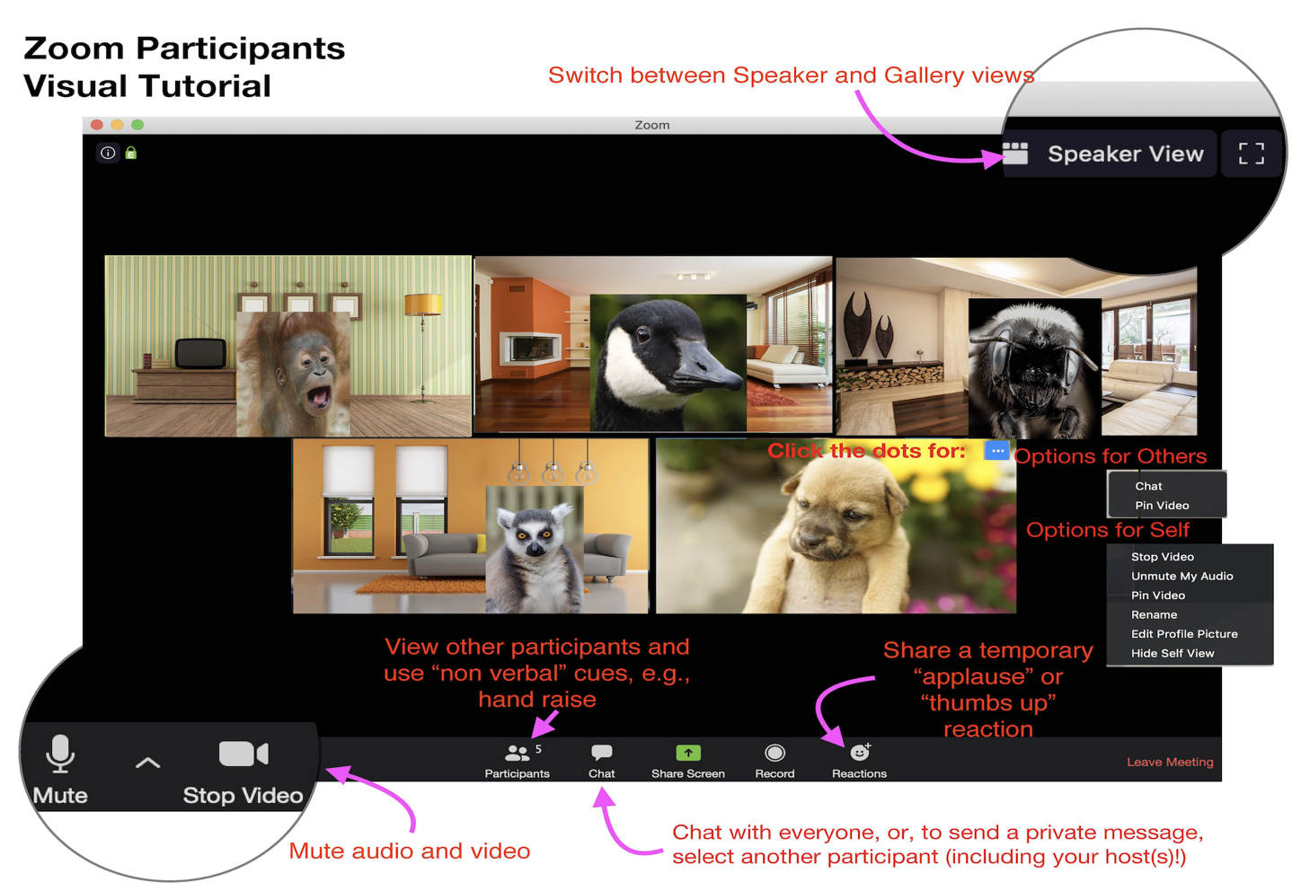
On the Phone? *6 - Toggle mute/unmute *9 - Raise hand
Notes:
Explain any other details of your platform from the learner/user perspective.
ZOOM INFORMATION: PARTICIPANTS
Participants should be introduced to your video conference platform at the beginning of your training. The visual tutorial above provides information about how attendees can virtually raise their hands, use the chat function and control their microphone and video stream.
In addition, you may also utilize the following features with your attendees:
Annotations: While sharing their screen, the host should direct attendees to click the “View Options” menu, and then the “Annotate” option at the top. This will open a menu of Annotation Tools that participants can use to respond during activities.
Polls: Once a meeting host “launches” a poll question, all attendees will receive a pop-up window allowing them to participate, and showing the poll results, once released by the host.
Breakout groups: The meeting host is responsible for assigning, opening and closing breakout rooms. When rooms are designated as open, participants will receive a pop up invitation to join their assigned room.

Slide 14
BREAKOUT GROUPS… REPORT BACK
Notes:
Small group activities are recommended to help participants feel safer to share their opinions and experiences. We encourage you to include as many small group activities as you can accommodate. Instruct each group to designate someone to "report back" to the larger group after each breakout session.
While these activities are usually very helpful for participants, we recommend that you pay close attention to power dynamics within the groups and accommodate as needed to ensure that participants who belong to historically marginalized/underrepresented communities can feel as safe and included as possible.

Slide 15
What aspects of Effective Team Communication come to mind for you?
Notes:
Ask this question to the group and invite reflection before allowing for 15-20 minutes of discussion in small groups.

Slide 16
BREAKOUT GROUPS… REPORT BACK
Notes:
Give participants a 1-2 minute warning before closing the breakout rooms to allow for closure in conversations. Ask one person from each group to share key insights from their group, without naming their colleagues or exposing sensitive details.

Slide 17

Oregon Facts
Oregon’s growing businesses are creating a construction boom!
Construction trade diversification goals are aimed at hiring larger numbers of females and diverse community members.
Publicly funded projects require that jobs are equitably attained by workers from all demographic representations.
Diversifying the workforce has a direct impact on improving Oregon’s economy.
Source: Wooley, JM (2018). Portland Metro Region Construction Workforce Market Study.
Notes:
Draw on the conversation from the small group discussions to further the reflection about the need to increase cultural intelligence to enhance team performance.

Slide 18

Industry Specific Research Findings
Unfair Treatment
Discrimination (race, age, gender, ethnicity, sexual identification, etc.)
Bullying
Racism
Harassment
Sexism
Sources: Wooley, JM. (2018). Portland Metro Region Construction Workforce Market Study. (1-28). Wilkinson, L. and Kelly, M. (2016). (Still) Building A More Diverse Workforce In The Highway Trades: 2016 Evaluation Of The ODOT/BOLI Highway Construction Workforce Development Program. (1-41). Arevalo-Meier, N. (2014). Status Report on the Disproportionately high termination rate for African American Apprentices in 2006-2010. (1-34).
Notes:
Although there are many unfortunate situations in society and the industry, research shows that these specific examples of unfair treatment prevail in the industry. Many of the discussions of this curriculum with focus on these examples.
Spend some time on this slide. It is important for participants to grasp the reality of the issues that exist on job sites. Be prepared for some participants share personal stories of having such things happen to them. Hold time for such conversations.
Recall:
Adult learners want acknowledgement for prior life experiences and knowledge
Adult learners want to experience self-directed processes leading to discovery

Slide 19
Learning Goals
Identify High 5 Teams effective cross- cultural communication skills
Understand why diverse cultural communication skills are required in labor industries
Analyze how effective communication skills improves team trust and productivity
Differentiate effective and ineffective communication practices
Formulate more inclusive and ways of communication within diverse teams
Put into practice the High 5 Teams communication skills

Slide 20

Research Recommendations
Taking Action
Establish an inclusive, equitable, and diverse construction (worksite) or cultural work environment.
Establish respectful places of work.
HOW?
Sources: Wooley, JM. (2018). Portland Metro Region Construction Workforce Market Study. (1-28). Wilkinson, L. and Kelly, M. (2016). (Still) Building A More Diverse Workforce In The Highway Trades: 2016 Evaluation Of The ODOT/BOLI Highway Construction Workforce Development Program. (1-41). Arevalo-Meier, N. (2014). Status Report on the Disproportionately high termination rate for African American Apprentices in 2006-2010. (1-34).
Notes:
This slide offers participants an opportunity to share their views on ‘how’ inclusive and diverse work environments can be established. Participants may also want to share positive or negative examples from past experiences.
Optional: Share your own view on how inclusive, diverse teams can be established.

Slide 21
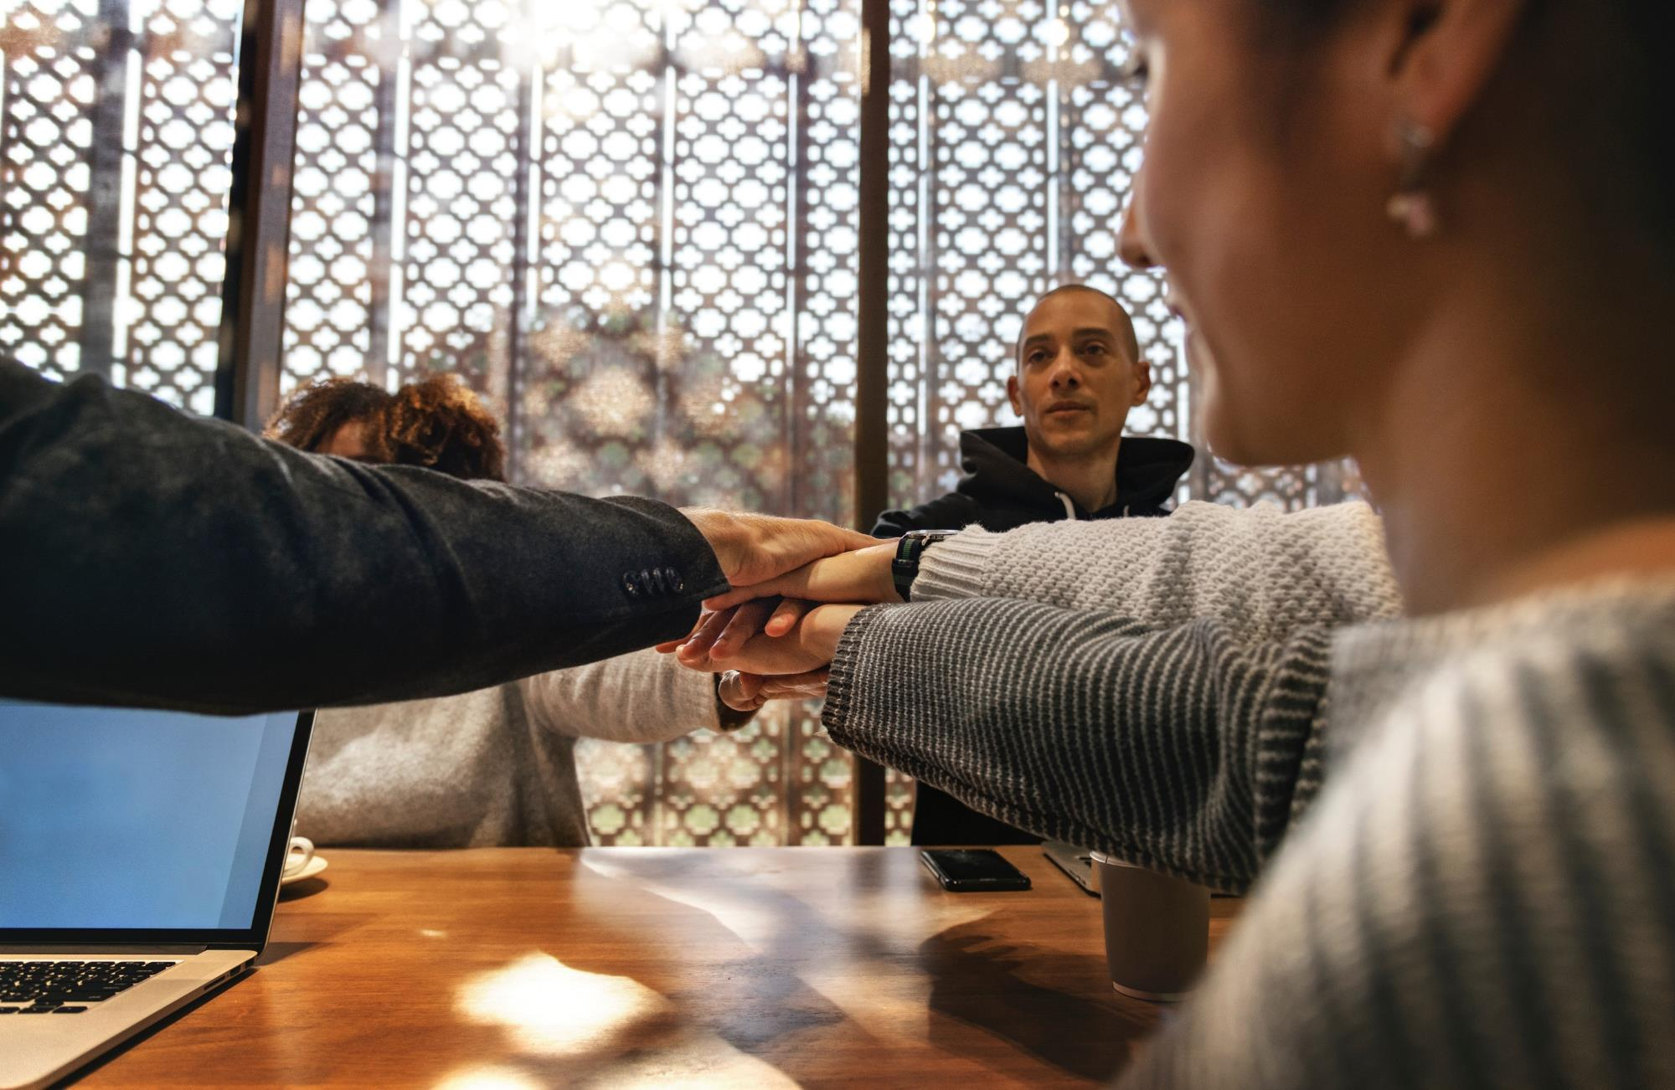
We are ALL on this Journey

Slide 22
QUESTIONS/COMMENTS/CONVERSATION
Notes:
Make sure to check in frequently to gauge participant's reactions/reflections and engagement level.

Slide 23

What is effective communication?
Definition
Effective communication is a process of transmitting information, an exchange of ideas, thoughts, knowledge and information such that the purpose or intention is fulfilled in the best possible manner.
In simple words, it is the presentation of views by the sender in a manner best understood by the receiver.
Notes:
In simple words, Effective Communication is the presentation of views by the sender in a manner best understood by the receiver. However, we all know that we are here because this is easier said than done. As human beings, our communication is usually not so simple. The fact is that real communication is a 2-way street and means nothing if the receiver does not receive the message.
Ask attendees, "What are some instances when this has happened to you?" Ask for examples to be added in the chat, or discussed in breakout rooms.

Slide 24
BREAKOUT GROUPS… REPORT BACK
Notes:
Small group activities are recommended to help participants feel safer to share their opinions and experiences. We encourage you to include as many small group activities as you can accommodate. Instruct each group to designate someone to "report back" to the larger group after each breakout session.
While these activities are usually very helpful for participants, we recommend that you pay close attention to power dynamics within the groups and accommodate as needed to ensure that participants who belong to historically marginalized/underrepresented communities can feel as safe and included as possible.

Slide 25
What are some barriers to effective communication that you have encountered in the workplace?
Notes:
A designee from each group should be prepared to report back after the allotted time. Breakout session time may varying depending on the number of participants and time available.

Slide 26
BREAKOUT GROUPS… REPORT BACK
Notes:
Give participants a 1-2 minute warning before closing the breakout rooms to allow for closure in conversations. Ask one person from each group to share key insights from their group, without naming their colleagues or exposing sensitive details.

Slide 27

What is cultural intelligence (CQ)?
Definition
Cultural intelligence is the capability, or cultural quotient to relate and work effectively across cultures.
Cultural intelligence is the ability for people to relate to culturally diverse situations and work effectively in them.
Notes:
As you can tell, one of the main barriers to effective communication resides in the way we relate to our own culture and the culture of others. First, let's examine what we mean by culture and why how we relate to culture is so important - because although diversity increases performance, it can also increase conflict.

Slide 28
Module 1 High 5 Teams
Effective Team Communication and Cultural Intelligence
Notes:
Let´s explore what we mean by an increase in conflict, as well as performance.

Slide 29
What Do You Think?
Working teams are diversifying in Oregon. Developing culturally informed communication skills helps build more productive teams.
1 True
2 False
Circle all which are identified as cultural groups in Oregon:
1 Pacific Islanders | 2 Russians | 3 LGBTQ+ 4 Farmers
5 Poverty/Poor | 6 White/Caucasian | 7 Hmong 8 Somalians
 | 8 Lawyers | 9 Contractors 10 Nurses
Notes:
This activity is great way to check in and get group engagement from your attendees. For in-person trainings, allow participants to verbally call out the correct answer, or write down their answers and discuss with their table group.
For virtual environments, make use of the pool tool in Zoom. You may need to remind attendees to exit the poll window after the results are shared.

Slide 30

Goal
To construct respectful and productive team by developing effective, culturally adaptable communication skills.
Objective
So that culturally inclusive working teams and work environments are established.
Notes:
Effective CQ communication is also known as: multicultural, cross-cultural, cultural aptitude/competency communication.
Group Conversation Prompt: Inclusive work environments What would that look like? What would be present? What would not be observed or heard?

Slide 31
What is cultural intelligence (CQ)?
Definition
Cultural intelligence is the capability, or cultural quotient to relate and work effectively across cultures.
Cultural intelligence is the ability for people to relate to culturally diverse situations and work effectively in them.
Notes:
As you can tell, one of the main barriers to effective communication resides in the way we relate to our own culture and the culture of others. First, let's examine what we mean by culture and why how we relate to culture is so important - because although diversity increases performance, it can also increase conflict.

Slide 32
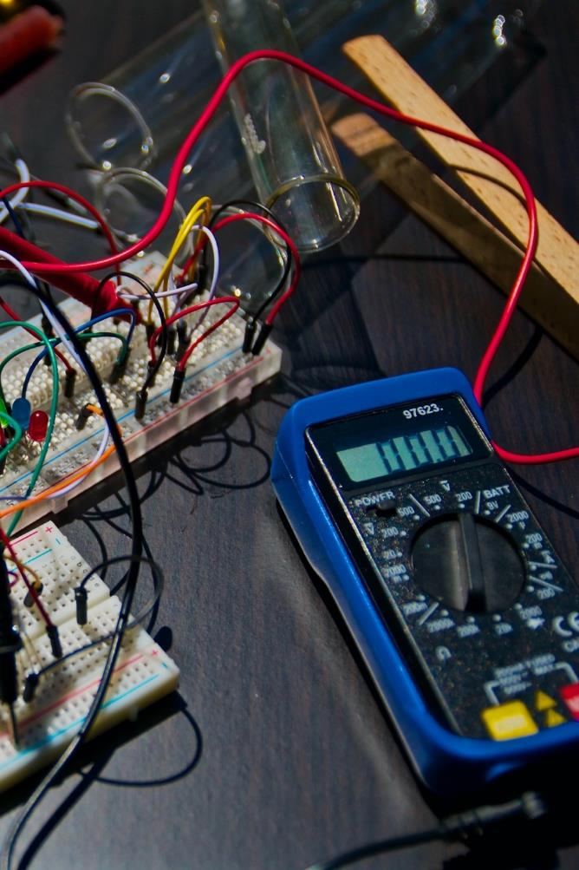
Tools of the Trade
There are tools for the trade and there are tools for communication.
You already apply the High-5 Elements in your work:
You evaluate what tools you’ll need
You navigate the working space
You negotiate sequence of how and when tasks are done
You collaborate as a team (no one does it all)
And, you co-operate with your team to get the job done!
Now we apply the same to our communication . . . .
Notes:
This slide is a preview of the High-5 Team elements. Remind learners that they are already applying the 5 elements in their work. Ask how else these skills might be used.

Slide 33
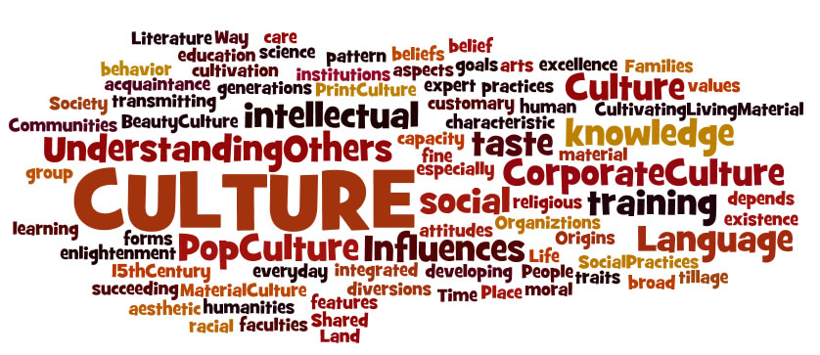
In order to do this we need to start with understanding Culture
Notes:
Since this curriculum is about Cultural Intelligence, the rest of Module 1 will explore the topic of Culture. We recommend that you prepare thoroughly prior to presenting this lesson. Become familiar with the content of this module and aim to dive deeper into this fascinating topic!

Slide 34
PLEASE TYPE IN THE CHAT: WHAT IS CULTURE TO YOU?
Notes:
Depending on the training platform/location, and the group’s dynamic and size this reflection can also be done verbally.

Slide 35
What is culture?
Culture is the way we all make sense of the world
EVERYONE regardless of race or ethnicity has a culture
Our brains use cultural information to give everyday events meaning

Slide 36
What is culture
Culture is integrated patterns of human behavior that include the language, thoughts, communication, actions, customs, beliefs, values, and norms of racial, ethnic, religious, or social groups
Ethnic groups have cultures; businesses have cultures; neighborhoods have cultures
It is dynamic and changes over time
There is diversity within cultures
Notes:
Each person is a member of many cultures

Slide 37

Think of cultural intelligence as widening our cultural aperture

Slide 38
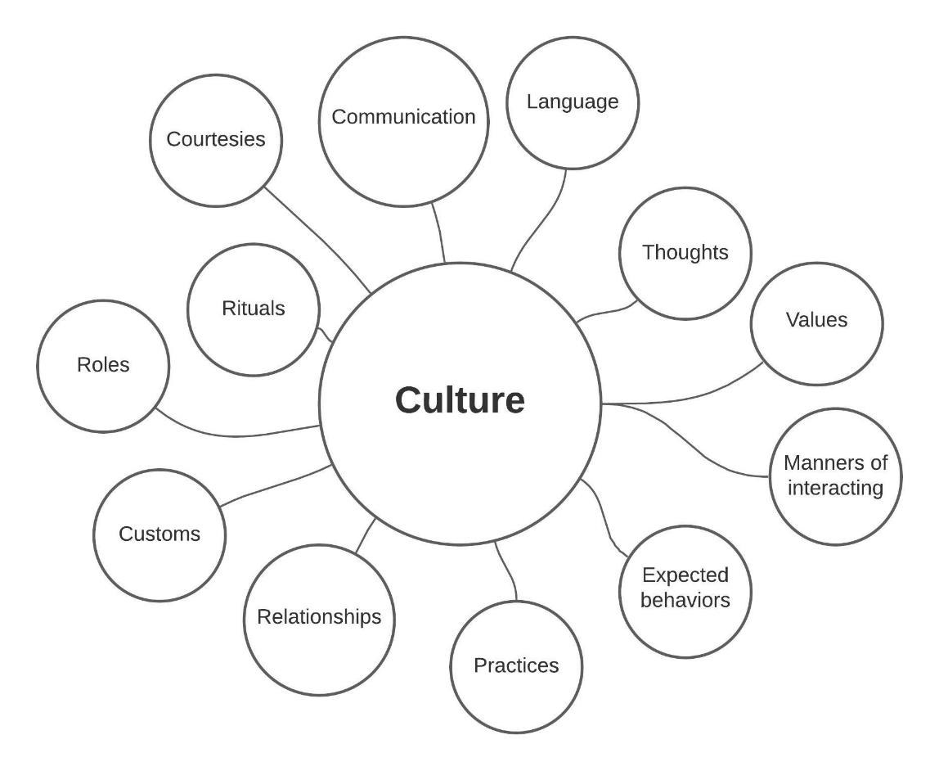
Everybody has a culture.

Slide 39


Making Meaning
Brain encounters new information
Searching→ making connections→
All based on one’s cultural frame of reference
Notes:
As social animals, we are all wired to our culture. Especially during reading, our brains search and make connection, find points of reference, and connect dots. Making these connections is an intrinsic part of being a human being, and can have positive and negative impacts.

Slide 40

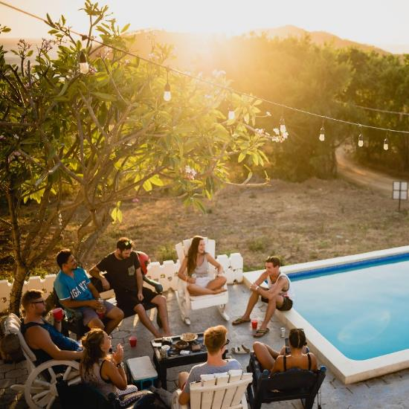
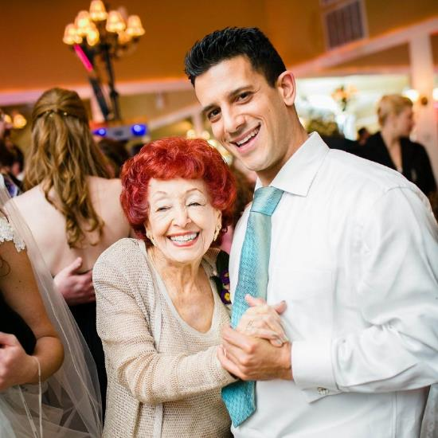
“Funds of Knowledge” What is a party?
Notes:
Here is one example from a personal experience. As instructors, you should try to adapt this to your own lived experience.

Slide 41
Check Your Filters
Police Scanner
Family
Colleagues
Journals
Church
Organizations
Movies
Music
Art
Books
Magazines
Restaurants
What else?
CNN
MSNBC
FOX News
FACEBOOK
Friends
USA TODAY
Twitter
Wall Street Journal
New York Times
Oregonian
KGW
NPR
KATU
Notes:
This slide is used to help illustrate that we are like sponges that absorb information from anything and everything we are exposed to. You can customize this list of examples, or ask participants to come up with their own list.

Slide 42
BREAKOUT GROUPS… REPORT BACK
Notes:
Small group activities are recommended to help participants feel safer to share their opinions and experiences. We encourage you to include as many small group activities as you can accommodate. Instruct each group to designate someone to "report back" to the larger group after each breakout session.
While these activities are usually very helpful for participants, we recommend that you pay close attention to power dynamics within the groups and accommodate as needed to ensure that participants who belong to historically marginalized/underrepresented communities can feel as safe and included as possible.

Slide 43
Identify Your Cultural Framework
What is the story of your family?
Has your family been here for a few years or decades?
How did your family identify ethnically or racially?
Where did you live (urban, rural, suburban)?
How would you describe your family economics (middle, upper middle, low-income, working class)? What did that mean in terms of quality of life?
Were you the first in your family to attend college?
What family folklore or stories did you regularly hear growing up?
What are some of your family traditions?
Who were the heroes celebrated in your family and/or community? Why?
Who were the anti-heros (the bad guys)?
Source: Hammond, Z. (2014). Culturally responsive teaching and the brain. Thousand Oaks, CA: Corwin
Notes:
Ensure participants have access to these questions prior to sending them to breakout groups.

Slide 44
BREAKOUT GROUPS… REPORT BACK
Notes:
Give participants a 1-2 minute warning before closing the breakout rooms to allow for closure in conversations. Ask one person from each group to share key insights from their group, without naming their colleagues or exposing sensitive details.

Slide 45
Please report back. What is coming up for you?

Slide 46
Begin with Intention
FIRST…. Identify your cultural framework
THEN…
Widen your cultural aperture

Slide 47
“Cultural Intelligence”
Personal connections give us perspective
Engages our attention
Helps us make meaning
Understand new ideas
Conceptualize
Reason
Theorize

Slide 48
Ethnicity-Race-Culture
What’s the difference?

Slide 49
Ethnicity-Race-Culture
Culture - Ethnicity - Race :
Culture is learned
Ethnicity is inherited
Race is socially constructed
Notes:
What does is mean that race is socially constructed? Please refer to the glossary appendix for more information, and be sure to allow time for some healthy/constructive discussion with the group. However, if the conversation becomes unproductive or goes too far off topic, remind participants that this curriculum is not about race or ethnicity, but focuses on communication.

Slide 50
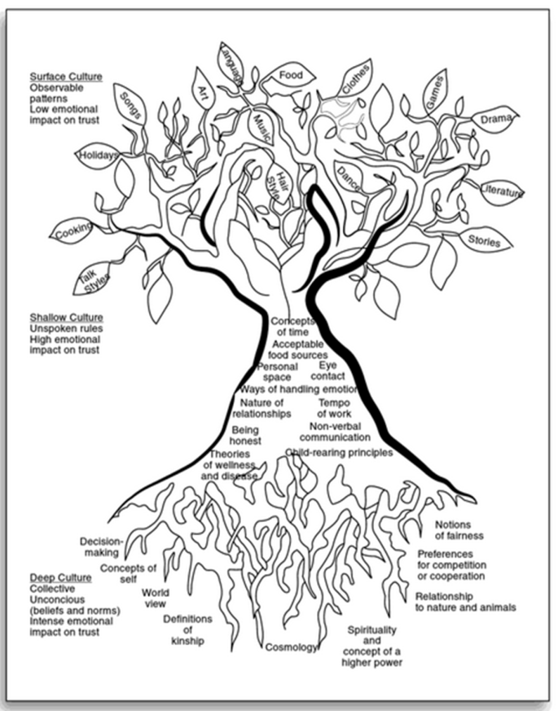
Culture Tree
Source: Zaretta Hammond, 2014 Culturally Responsive Teaching and the Brain.
Notes:
This curriculum is about understanding culture: Cultural intelligence is understanding and respecting other people´s cultures.

Slide 51

Three Levels of Culture
Surface
Shallow
Deep
Source: Hammond, Z. (2014). Culturally responsive teaching and the brain. Thousand Oaks, CA: Corwin

Slide 52
Surface culture
Talking styles
Holidays
Art
Music
Clothes
Dance
Drama
Stories
Cooking
Songs
Language
Food
Hair style
Games
Literature

Slide 53
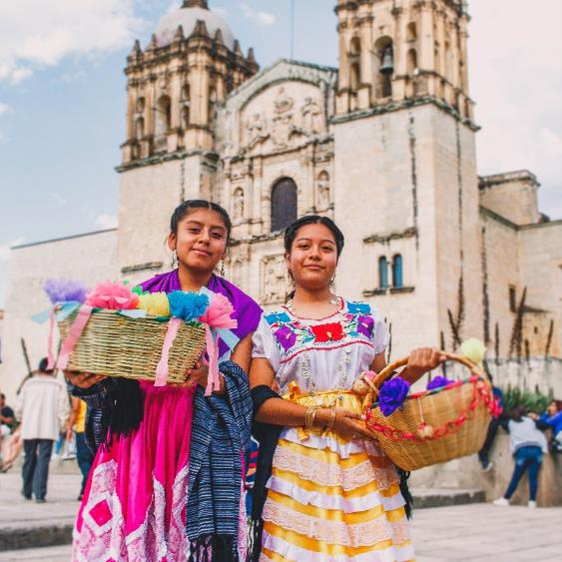
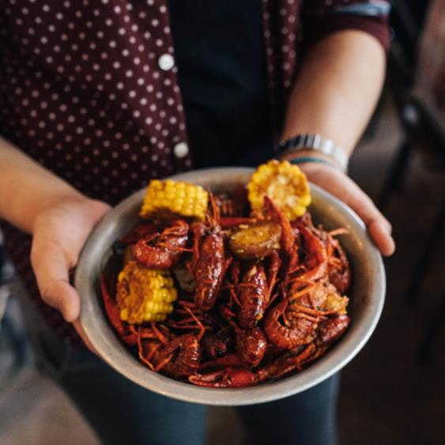
Surface Culture Examples
Latino culture – importance of appearance
Cajun – emphasis on food
Notes:
There are many other examples of Surface Culture, such as:
Cajuns are one of the most unique cultures and ethnic groups in the United States. Primarily located in rural Southern Louisiana, the culture is defined by its French roots which are easily seen in their own distinct Cajun French dialect, societal norms, music, and food.
Please feel free to use other examples from your own lived experience, or ask participants to identify their own examples.

Slide 54
Surface Culture
Observable, concrete
Low emotional impact on trust
Does not produce great anxiety
“Culture fairs”
Notes:
It is important to remember that we are all the product of various cultural influences, and applying cultural stereotypes to individuals must be avoided.

Slide 55
Shallow Culture
Concepts of time
Personal space
Ways of handling emotion
Tempo of work
Non-verbal communication
Child-rearing principles
Acceptable food sources
Eye contact
Nature of relationships
Being honest
Theories of wellness and disease
Notes:
Shallow culture affects the way we navigate the world and is influenced by the aspects of our unique personality, and the intersection of our identities. Shallow culture also influences how we see and interpret what others do.

Slide 56
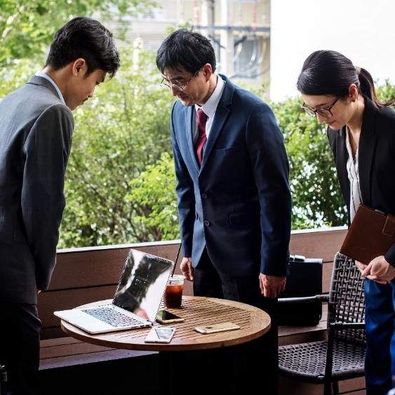
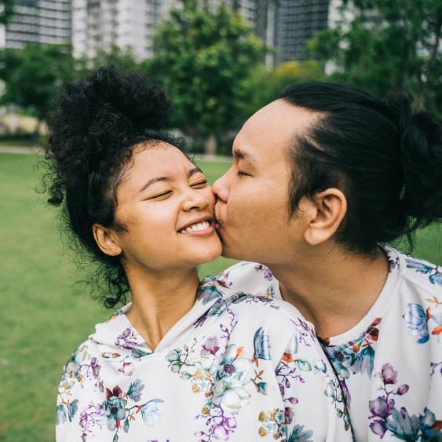
Shallow Culture Examples
Greetings – eye contact (Thailand, Japan, Latin America, France, USA, etc.)
Notes:
My own example: kissing and saying hi while doing MS in forestry..
Thinking nobody liked me… others perceiving me as inappropriate

Slide 57
Shallow Culture
Deep values begin at this level
Unspoken rules
High emotional impact on trust

Slide 58
Violations of Norms
Mistrust
Distress
Social friction
Hostility
Feel disrespected
Shutting down
Notes:
Like in my example as an international student

Slide 59
QUESTIONS/COMMENTS/CONVERSATION
Notes:
Make sure to check in frequently to gauge participant's engagement level.
In virtual environments, you can ask participants to type in the chat or unmute their microphone to help encourage participation.

Slide 60
Deep Culture
Decision making
World view
Relationship to nature and animals
Notions of fairness
Concepts of self
Definitions of kinship
Spirituality and concepts of a higher power
Preferences for competition or cooperation
Notes:
Deep culture includes the most sacred and sensitive parts of ourselves.

Slide 61

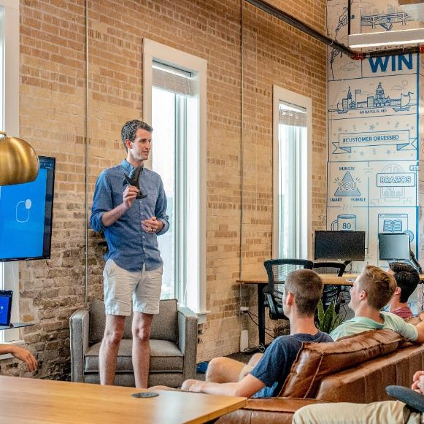
Deep Culture Examples
Japan Genkan
Shoes = dirty
Tatami mats and inside = clean
Presentations - Concepts of self and what is considered professional or appropriate

Slide 62
Deep Culture
Collective knowledge
Unconscious assumptions
Intense emotional impact on trust
Brain interprets threats or rewards
Cosmology= View of good & bad
Honor/Shame
Notes:
Deep culture is where our unconscious bias kicks in.

Slide 63
Deep Culture Guides
Ethics
Spirituality
Health
Worldview
Group harmony
How we function in society
How we interact with others: communicate

Slide 64
Violations of Norms
Culture shock
Fight or flight response
Highly emotional
We carry these norms throughout our life
We can change our geography but it is very difficult to change our deep culture.

Slide 65
Culture Tips
Don’t focus on the “leaves” shallow of culture
Do focus on surface & deep culture and how it guides the way we interact with others

Slide 66
Our mental models stay with us forever…
“You can take the kid out of the country, but you can’t take the country out of the kid.”

Slide 67
Schema = Background Knowledge
Information we take in
Process
Interpret
Categorize based on our deep cultural norms

Slide 68
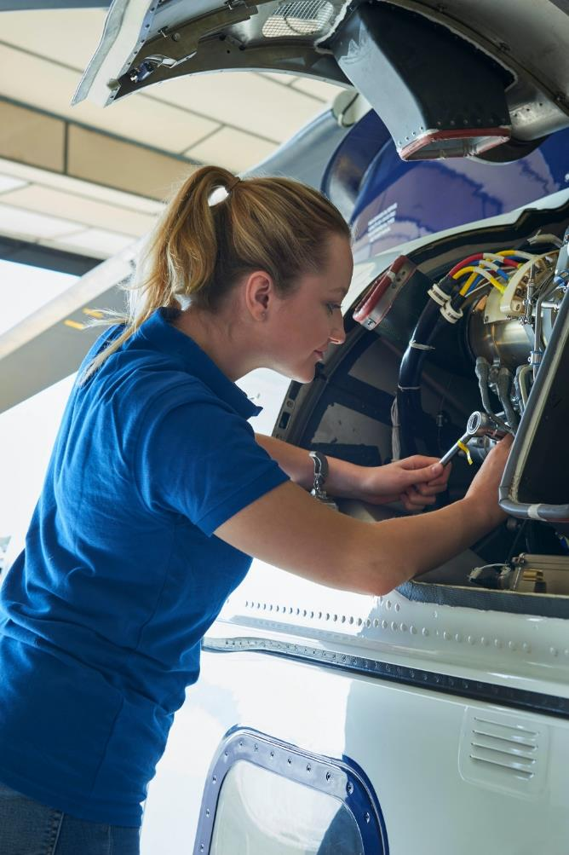
How does this relate to the High 5 framework?

Slide 69
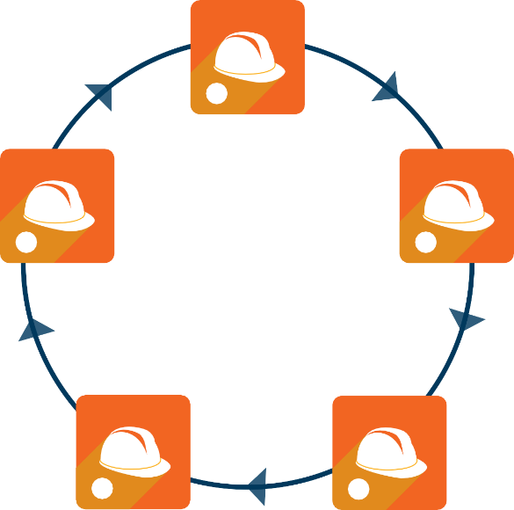
EVALUATE
1
COOPERATE
NAVIGATE
ELEMENTS OF
EFFECTIVE
5
2
COMMUNICATION
COLLABORATE
NEGOTIATE
4
3
Instructor Note 10
Notes:
Remind participants of the High-5 elements, and continue to introduce and establish these concepts through reinforcement and repetition.

Slide 70

What is effective communication?
Effective communication is a process of transmitting information, an exchange of ideas, thoughts, knowledge and information such that the purpose or intention is fulfilled in the best possible manner.
In simple words, it is the presentation of views by the sender in a manner best understood by the receiver.

Slide 71

“We don't see things as they are, we see them as we are.”
Anais Nin

Slide 72
BREAKOUT Diversity Wheel
Notes:
The objective of the Diversity Wheel activity is to understand how our cultural differences are expressed in many ways, including age, sexual orientation, race, physical ability, education, religion etc. Some of these aspects are observable (surface culture), while others are embedded in our thinking and personality (shallow and deep culture).
Distribute the following instructions and Diversity Wheel image to participants prior to sending them to breakout groups.
Instructions:
Allow 20-25 minutes for this activity.
Choose two dimensions from the wheel to focus on for this activity and clearly identify the aspects of diversity (differences) that you bring to these two factors. What strengths/advantages do these two differences bring to the work group? Be as specific as you can. What potential conflicts are created because of the two differences you bring to a work group/team? Have you ever felt like an “outsider” in a work group because of the differences you identified? Think about a strategy you have used to either maximize the strength of a difference you identified, OR to minimize the conflict associated with a difference you identified.

Slide 73
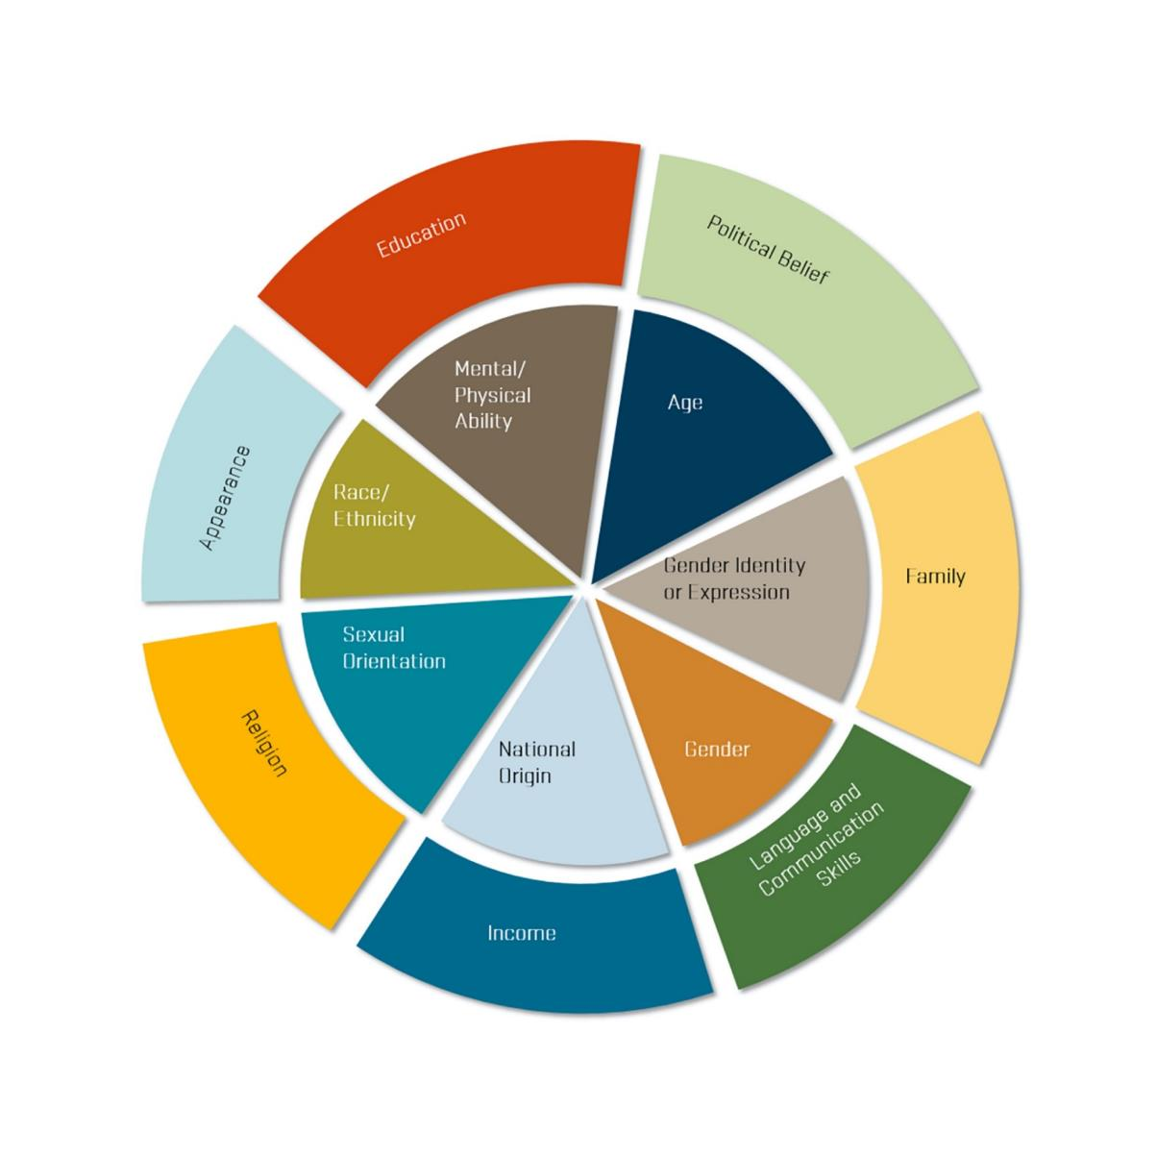
The Diversity Wheel

Slide 74
Choose two dimensions from the wheel to focus on for this activity and clearly identify the aspects of diversity (differences) that you bring on these two factors. What strengths/advantages do these two differences bring to the work group? Be as specific as you can. What potential conflicts are created because of the two differences you bring to a work group/team? Have you ever felt like an “outsider” in a work group because of the differences you identified? Think about a strategy you have used to either maximize the strength of a difference you identified, OR to minimize the conflict associated with a difference you identified.
Notes:
Activity adapted from Navigating Differences Curriculum (Washington State University Extension)

Slide 75
BREAKOUT GROUPS… REPORT BACK
Notes:
Give participants a 1-2 minute warning before closing the breakout rooms to allow for closure in conversations. Ask one person from each group to share key insights from their group, without naming their colleagues or exposing sensitive details.

Slide 76
Individual Writing Exercise
When OTHER people use the words “diverse” or “diversity” in your work environment, what do they mean?
When YOU use them, what do you mean?
What do you think these words SHOULD mean?
Notes:
This exercise provides you with an option for those learners that that might be less vocal or more introspective and prefer writing as a way to process and reflect. You do not have to use this activity in addition to the Diversity Wheel breakout group discussions, but some participants may consider it helpful.

Slide 77
QUESTIONS/COMMENTS/CONVERSATION
Notes:
Check in with your participants frequently to gauge group engagement and energy level.

Slide 78
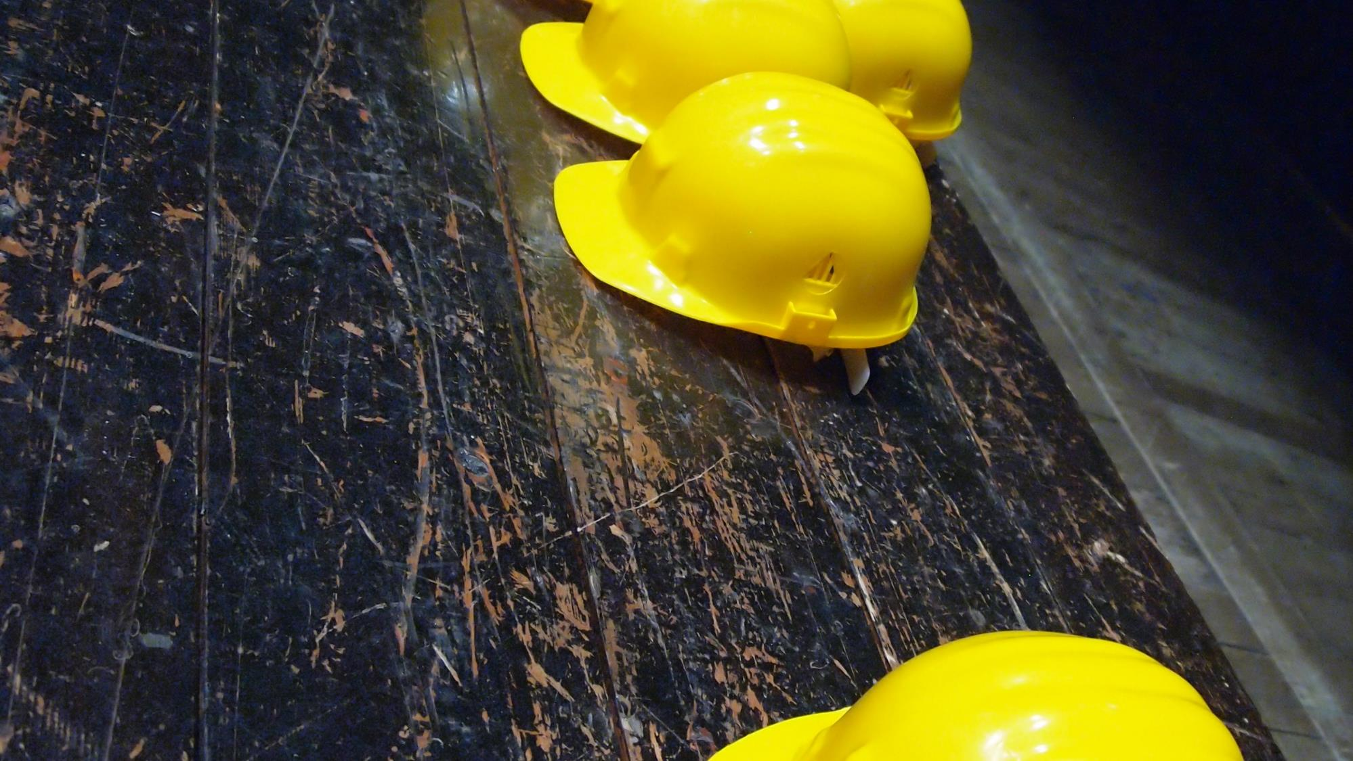
Each group will be provided a different case scenario to discuss. Read and discuss the work scenario then as a group respond to the following questions.
How would you handle the situation?
How would you apply CQ in your communication?
Describe which High-5 communication elements you would consider applying in the way you would respond to the issue you are facing?
Notes:
Encourage learners and participants to make use of the High-5 elements for Effective Team Communication:
You evaluate what tools you’ll need
You navigate the working space
You negotiate sequence of how and when tasks are done
You collaborate as a team (no one does it all)
And, you co-operate with your team to get the job done!
Address the following on the job scenarios. Provide the High-5 Element information on the following slide, along with the scenarios, to participants prior to the activity.
Instruct learners to use the High 5 Elements for Effective Team Communication handout, as well as the case scenario for this activity. You can prepare your own case scenarios or refer to the Case Scenarios Addendum to choose a scenario. Allow participants 20-25 minutes.
We will continue practicing these high 5 Elements for Effective Team Communication. These elements will get more consolidated with practice during the upcoming sessions

Slide 79
Evaluate, Navigate, Negotiate, Collaborate and Cooperate
EVALUATE
1. Evaluate – Check out the situation and positively assess each team member”s unique differences. Pay respectful attention to
“differences”, as identified by the team member themselves – careful not to make assumptions about: gender, ethnicity, class, race, sexual orientation, degree of learned/applied skills, etc. Formulate how you will effectively respond to the differences within the team and seek to find common ground; listen for the possibility of similar or shared lived experiences.
1
NAVIGATE
2. Navigate – To navigate is to take a course of action, plan, work through various circumstances and situations while acknowledging and recognized differences within team members. Practice non- discriminatory communication skills effectively. Understand the critical differences between being “tested” (rites of passage based on an apprentice” learned skills) and/or being “targeted”(based
on gender, sexual orientation, ethnicity, race, status, geographic birthplace, native tongue and language, age, etc.), as an apprentices is learning new skills.
2
NEGOTIATE
3. Negotiate – Work it out, come to terms (find a way over and through tense moments). Take the time to explore a different communication paths to maintain a working relationship. Negotiation requires active listening skills. Ask questions in a respectful way. If tensions arise a team member can ask, “What”s the issue?” Not – “What”s your problem?”
3
4. Collaborate – Work jointly, combine efforts, team mindset, an “all in it to win it” approach. This requires a give-and-take approach. No one way is always right. Be open to different ways of getting the job done.
COLLABORATE
5. Cooperate – Cooperation requires a team to work together safely, effectively, and productively – within a culture of trust. Honoring and respecting differences open up channels of communication. Demonstrating inclusive practices and processes requires effective communication skills. Cooperation is about how team members operate (work, handle, manage) their tasks together, as a collective with an “all in it to win it” attitude and approach.
4
COOPERATE
Key Point: Practice using High 5 team tools with skill and precision. Like any tool, High 5 skills are mastered over time with use and practice.
5
Notes:
HAND OUT: Participants should have a copy of the 5 key elements document in their packet to review, and serve as a constant visual aid. High-5 tools improve communication skills over time. Like any tool; High-5 skills are mastered over time with practice.

Slide 80
BREAKOUT GROUPS…. REPORT BACK
Notes:
Small group activities are recommended to help participants feel safer to share their opinions and experiences. We encourage you to include as many small group activities as you can accommodate. Instruct each group to designate someone to "report back" to the larger group after each breakout session.
While these activities are usually very helpful for participants, we recommend that you pay close attention to power dynamics within the groups and accommodate as needed to ensure that participants who belong to historically marginalized/underrepresented communities can feel as safe and included as possible.

Slide 81
On the Job Scenarios

Slide 82
BREAKOUT GROUPS…. REPORT BACK
Notes:
Give participants a 1-2 minute warning before closing the breakout rooms to allow for closure in conversations. Ask one person from each group to share key insights from their group, without naming their colleagues or exposing sensitive details.

Slide 83
NEXT SESSION
Notes:
Depending on how you are arranging your instruction of the High-5 Teams Curriculum, provide attendees with information for the next session, or any follow up that is needed.

